Slide 1
INVOLVE & EVOLVE

Slide 2
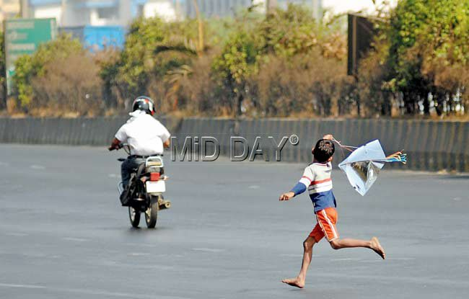

Slide 3
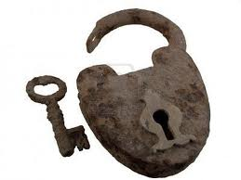

Slide 4
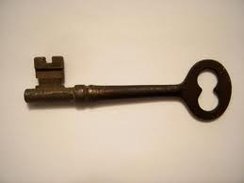
You are the key

Slide 7
Look beyond yourself
Extrapolate your ideas….

Slide 8
“VALUE OF TRAINING”
Training is invaluable

Slide 9
Confidence

Slide 10
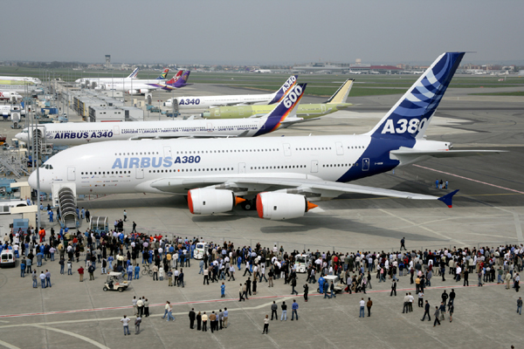

Slide 11
Create good will

Slide 13
WORKING WITH YOUR CLUB
UNDERSTAND THE CLUB
GUIDE, ADVISE AND SUPPORT TO ACHIEVE THEIR GOALS
CHANGE THE OUTLOOK

Slide 14
COMMON CHALLENGES THAT THE CLUB NEEDS TO OVERCOME
DISORGANISED / INEXPERIENCED CLUB LEADERSHIP
LACK OF INFORMATION REGARDING RI & DISTRICT RESOURCES
POOR ADMINISTRATION OF SERVICE PROJECTS AND CLUB FINANCE
IN-ADEQUATE PARTICIPATION IN DISTRICT MEETINGS
INACTIVE MEMBERSHIP
INSUFFICIENT SERVICE PROJECTS

Slide 15
Use intelligence while taking action.

Slide 16
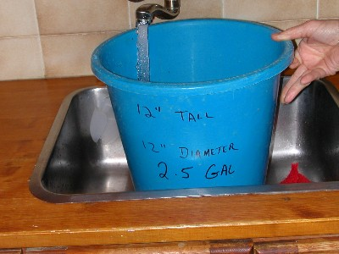
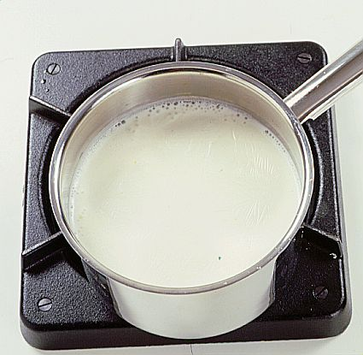

Slide 17
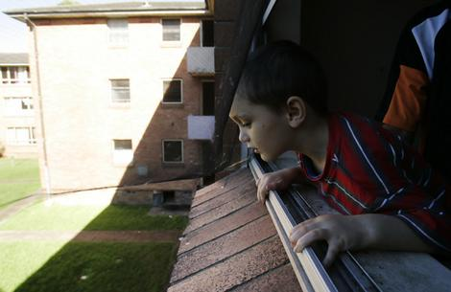

Slide 18
Intelligence is knowing consequences

Slide 19
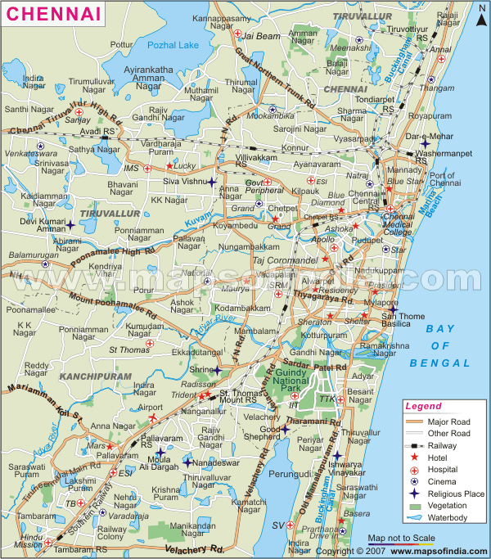
Shanivar Peth?

Slide 20
COMMUNICATION
GATHER INFORMATION ON SUCCESSFUL CLUB PROJECTS
SHARE THEM WITH OTHER CLUBS THROUGH DISTRICT WEB SITE, GML OR DISTRICT PROGRAMMES
DEVELOP PRESENTATION FOR CLUBS.

Slide 21
FACTORS YOU SHOULD KEEP IN MIND WHEN DEVELOPING A PRESENTATION
SHOULD INSPIRE INTEREST
SHOULD BE BRIEF: AVOID USE OF JARGONS
BE ORIGINAL
SUMMARISE MAIN POINTS

Slide 22
Have faith in your ideas

Slide 23
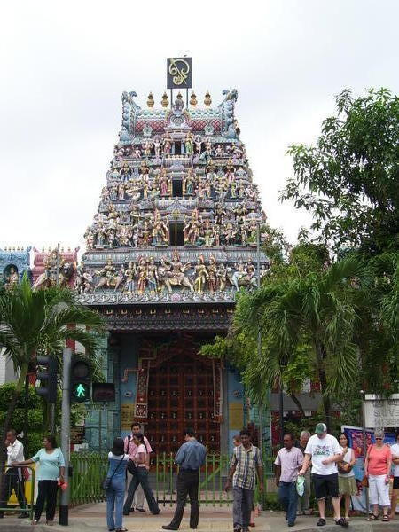
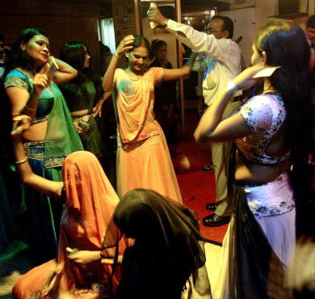

Slide 24
Faith! What is faith ?

Slide 26
Perception of integrity

Slide 27
Why should I let his rude behavior dictate my politeness

Slide 28
Best relations do not need Promises, Terms or Conditions.
They just need two wonderful persons.
One who can trust & other who can understand.

Slide 29
Your are not
just a key.
You are the
Master Key.

Slide 30
Wish you all the best for
2016-17
PDG Bansi Dhurandhar

