Slide 1
ALIGNING WITH R.I. GOALS
Rotary Club Central
Chetan Desai – Training facilitator Designate
District Training Assembly, Trident, Nariman Point
March 27, 2016
Notes:
Welcome – I am Pam Weaver, your district administrator. We are going to spend a few minutes doing an overview of some things that are available on the Rotary International Website – in My Rotary
Questions: Ask them! I may not know the answer, but chances are good that someone in the room will.
This is really just an introduction to what is available – you will need to explore in more depth on your own later
[CLICK]

Slide 2
Why to align Goals with RI Goals (Presidential Citation)?
While most of us are “legends in our own minds” and believe our Rotary club is phenomenal, winning the Presidential Citation is an objective and persuasive piece of evidence that your club REALLY IS phenomenal.

Slide 4
QUALIFICATION CRITERIA
MANDATORY ACTIVITIES
MEMBERSHIP ATTRACTION
AND ENGAGEMENT
Clubs must achieve both of the following goals:
Clubs must achieve 2 of the following goals:
Achieve a net gain in membership. Small clubs (up to 50 members) must achieve a net gain of at least one member; large clubs (51 or more members) must achieve a net gain of at least two members.
Improve the member retention rate by at least
1 percent from last year, or maintain 100 percent retention.
Induct new members under the age of 40. Clubs with up to 50 members must induct a minimum of two new members under age 40; clubs with 51 or more members must induct four. The new members must create profiles on My Rotary.
Set at least 10 goals in Rotary Club Central.
Pay semiannual dues to RI on time in July and January. Note: Verify your payment options on your club’s invoice or by contacting your financial representative.

Slide 5
FOUNDATION GIVING
In celebration of our Foundation’s centennial, several of these goals refer to the original donation of $26.50 that started The Rotary Foundation in 1917. Additionally, $536 is the approximate equivalent of $26.50 today.
Clubs must achieve 3 of the following goals:
Support our Foundation with a contribution of at least $536.
Support our Foundation with a contribution of at least $26.50 from each member.
Attain at least $2,650 in total giving to PolioPlus in honor of The Rotary Foundation centennial.
Attain a minimum Annual Fund contribution of $100 per capita.
Attain a five-year high in total club giving to the Foundation (combined giving by all members under any designation, with a minimum contribution of $26.50 per member) in honor of the Foundation’s centennial.
Increase the total number of Benefactors and Bequest Society members in the club by at least one.

Slide 6
ONLINE TOOL ADOPTION
PUBLIC IMAGE
All data for these goals will be automatically
recorded when the actions are taken.
Clubs must report in Rotary Club Central.
Clubs must achieve 2 of the following goals:
Have at least 50 percent of members identify their skills and interests in their My Rotary profiles, and unlock that section to make it visible on their public profiles.
Post at least one initiative in Rotary Showcase.
Post a project in need of assistance in Rotary Ideas or contribute to a project in Rotary Ideas.
Have at least two members participate in discussion groups in My Rotary.
Clubs must achieve 1 of the following goals:
Host an event to inform the community about Rotary and its Foundation’s centennial. Report in Rotary Club Central.
Get local media to cover an outstanding club project. Report in Rotary Club Central.
Involve local media with at least one club event, project, or fundraiser. Report in Rotary Club Central.

Slide 7
HUMANITARIAN SERVICE
Clubs must achieve 3 of the following goals:
Have at least one club member attend a grant management seminar. Report in Rotary
Club Central.
Implement a project with one of Rotary’s service partners. See a current list of service partners at www.rotary.org/ partners. Report in Rotary Club Central.
Establish a partnership and conduct a project with one or more corporations, government entities, or nongovernmental organizations. Report in Rotary Club Central.
Enhance a project’s scope and visibility by partnering with at least five other Rotary clubs in your region. Report in Rotary Club Central.
Sponsor at least one Rotary Community Corps
to enhance community engagement and ensure project sustainability. Note: Your club’s RCC must be certified with Rotary International. Ensure that at least one club member belongs to a Board-recognized Rotarian Action Group (www.rotary.org/actiongroups).
Report in Rotary Club Central.
Partner with the Foundation by sponsoring at least one project funded by a global grant or a district grant.

Slide 8
NEW GENERATIONS
Clubs must achieve 3 of the following goals:
Currently sponsor or co-sponsor a Rotaract club.
Currently sponsor or co-sponsor a community- based Rotaract club.
Currently sponsor or co-sponsor an Interact club. Have at least one club member mentor a Rotaractor or Interactor. Report in Rotary Club Central.
Involve Rotaractors or Interactors in club projects and events. Report in Rotary Club Central.
Sponsor or host at least one Rotary Youth Exchange student. Report in Rotary Club Central.
Sponsor a participant in a RYLA event. Report in Rotary Club Central.

Slide 9
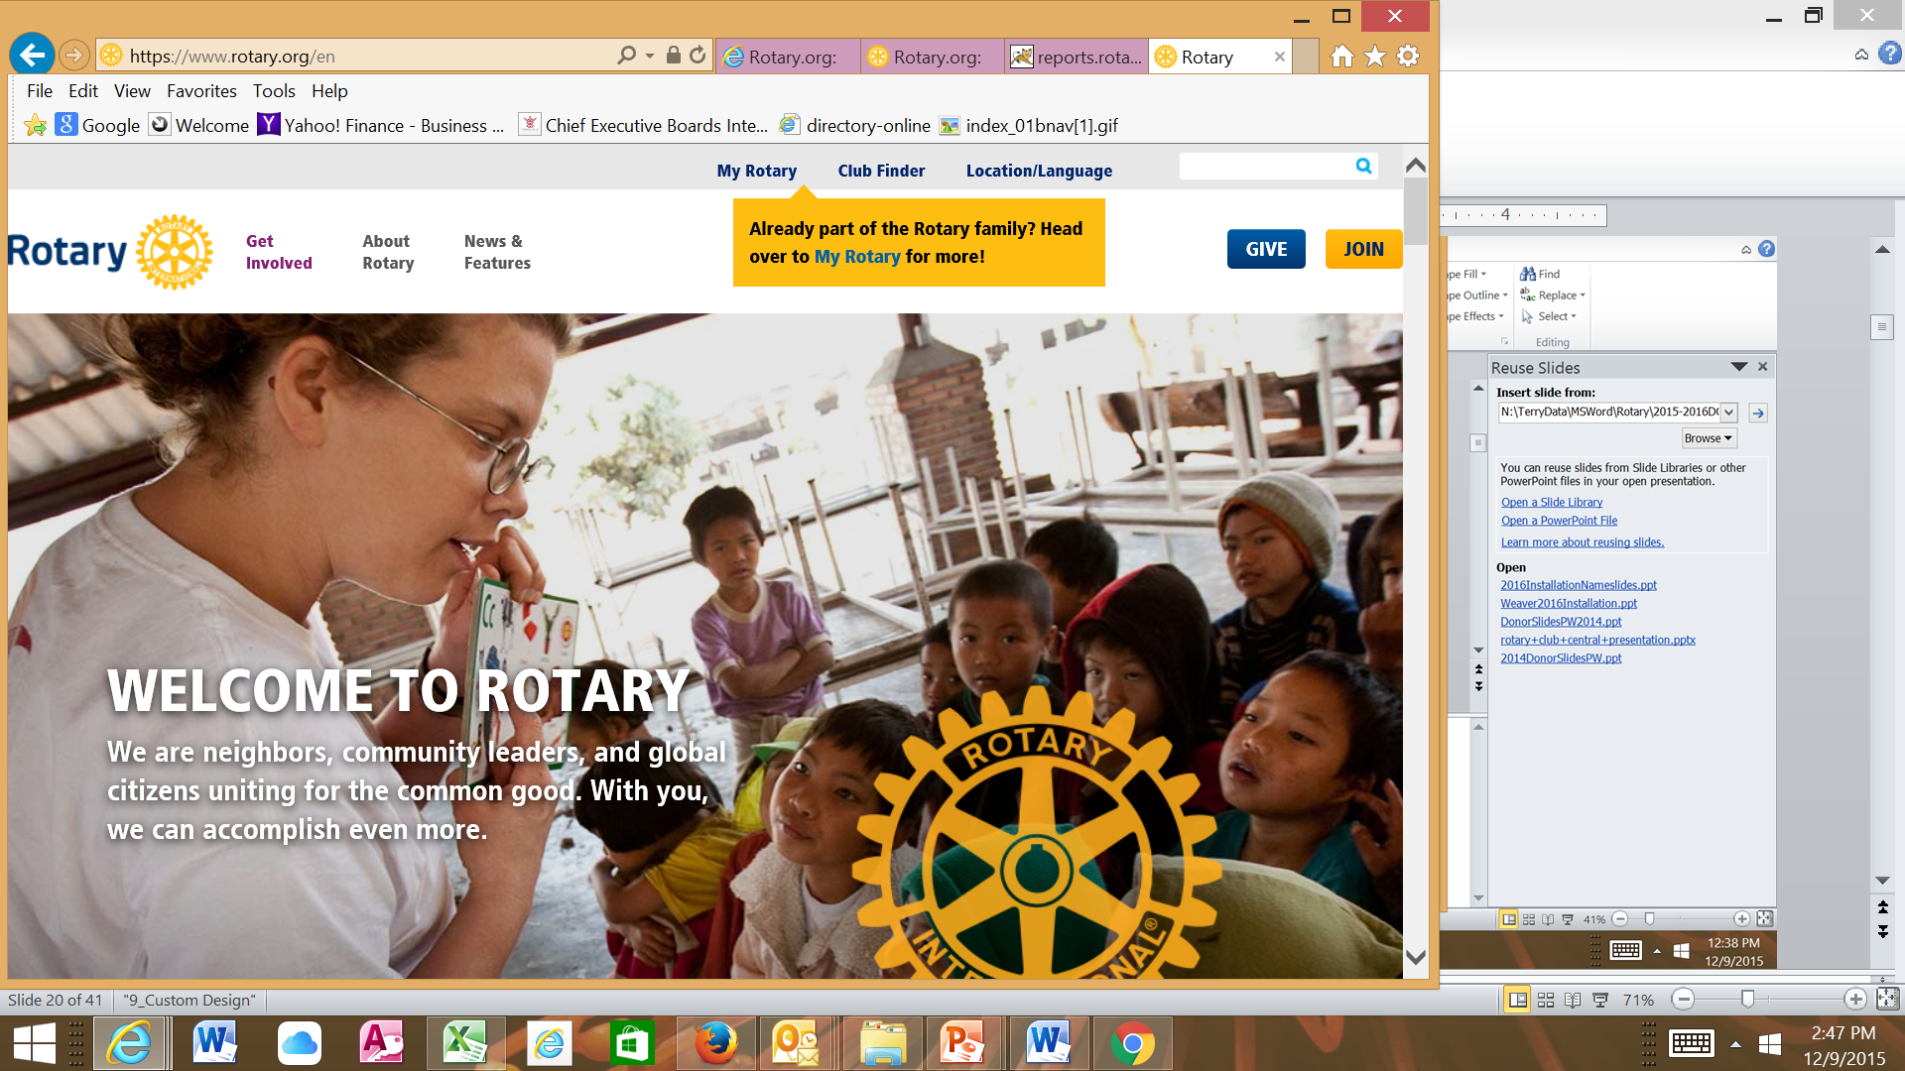

Slide 10
ROTARY CLUB CENTRAL IS EASILY ACCESSIBLE ON MY ROTARY
www.rotary.org/MyRotary
Log into My Rotary
Click: Manage/Club and District Administration/ Rotary Club Central
Notes:
WHERE is Rotary Club Central located?
It’s accessible on My Rotary – the member area of Rotary.org.
[CLICK]

Slide 11
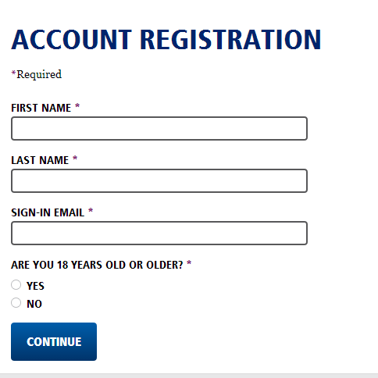
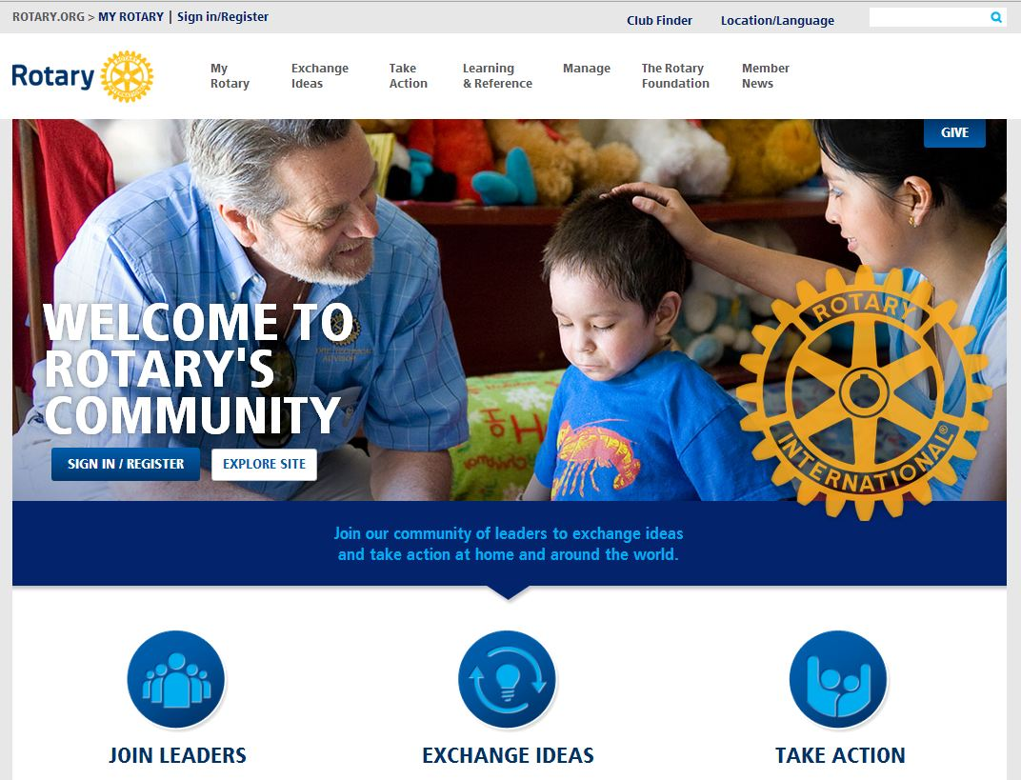
REGISTER OR SIGN IN TO MY ROTARY
Notes:
Register or Sign In to My Rotary
If you or one of your club presidents have not yet registered you (they) just click on the Sign In/Register button, then Create an Account. [CLICK]
Once you enter your name and email, and confirm you’re over 18, you’ll receive an email with a link to set your password. If you do not receive the email within 24 hours just check your spam or junk folder.
[CLICK]

Slide 12
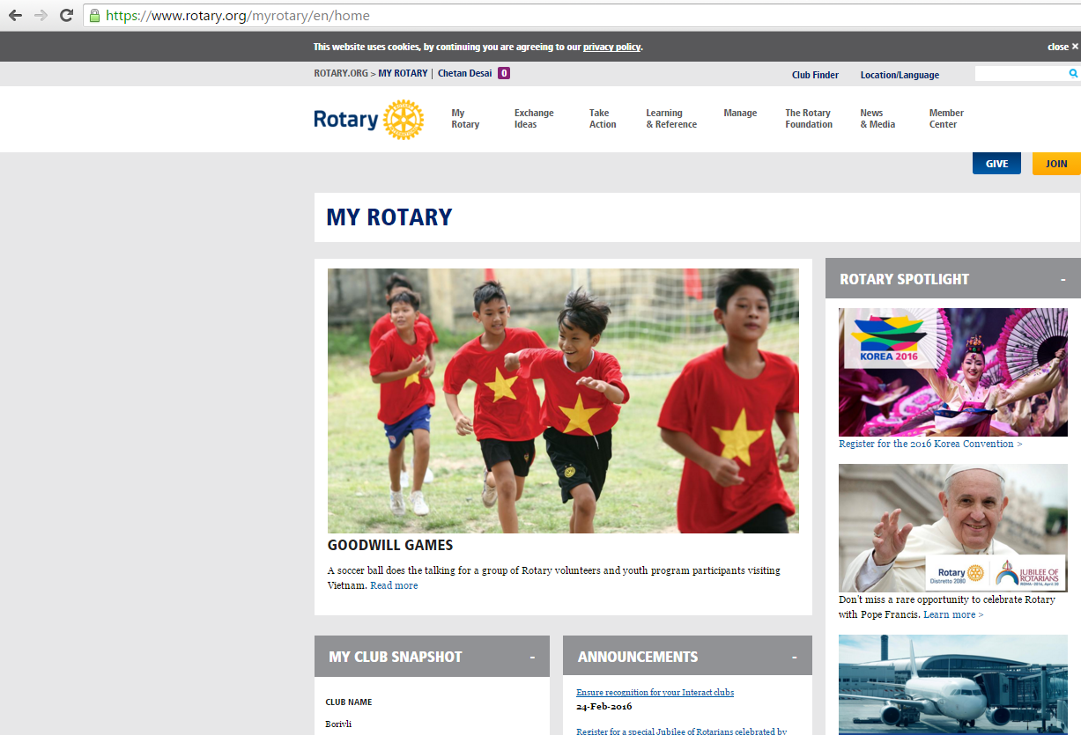

Slide 13
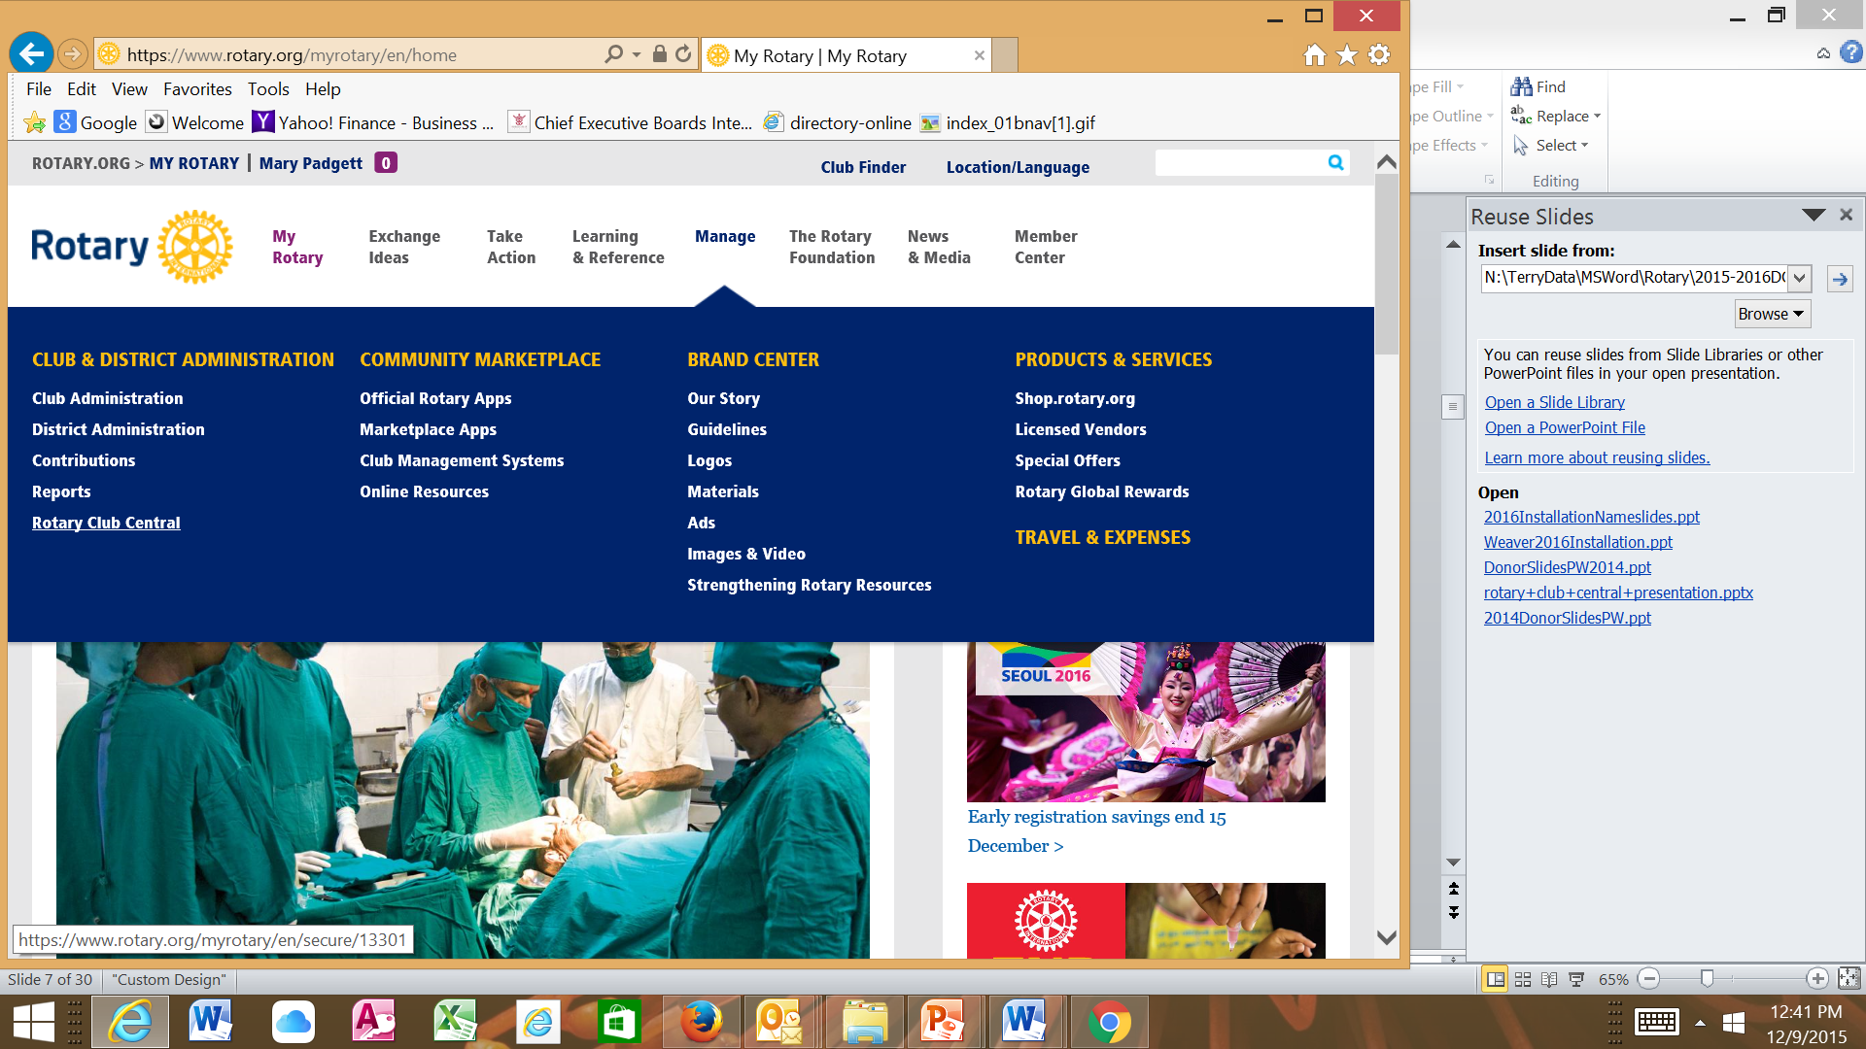

Slide 14
ROTARY CLUB CENTRAL
Help your clubs:
Enter and Edit Goals
Enter Progress Information

Slide 15
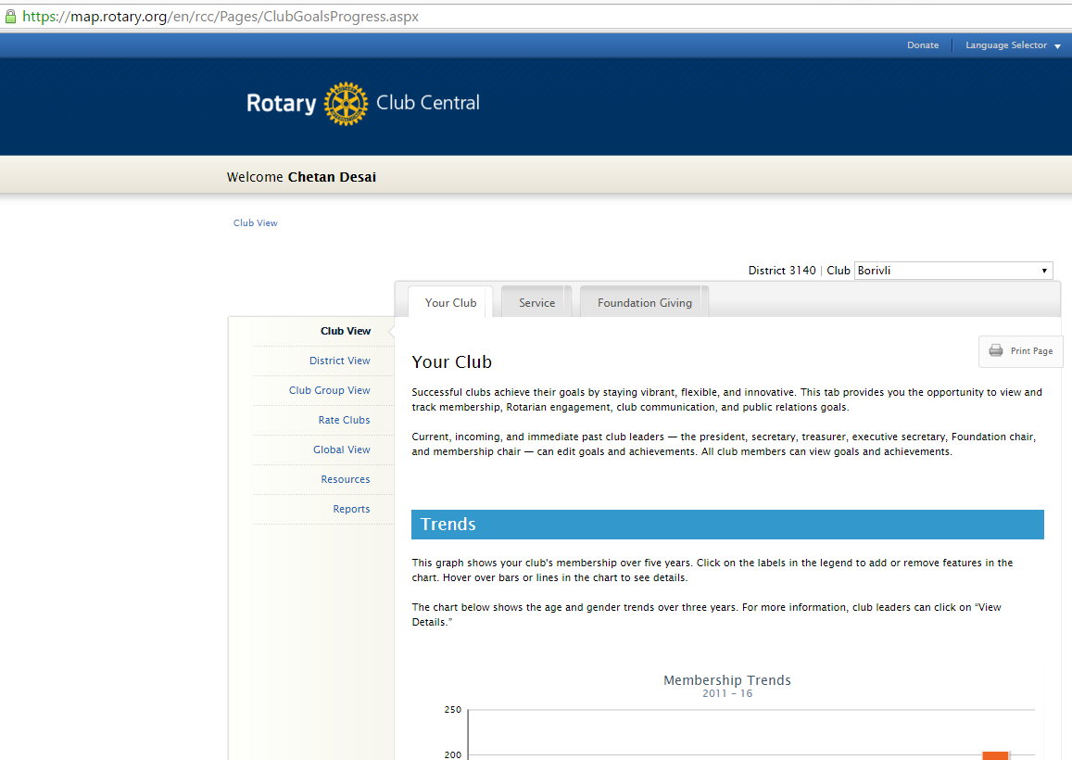

Slide 16
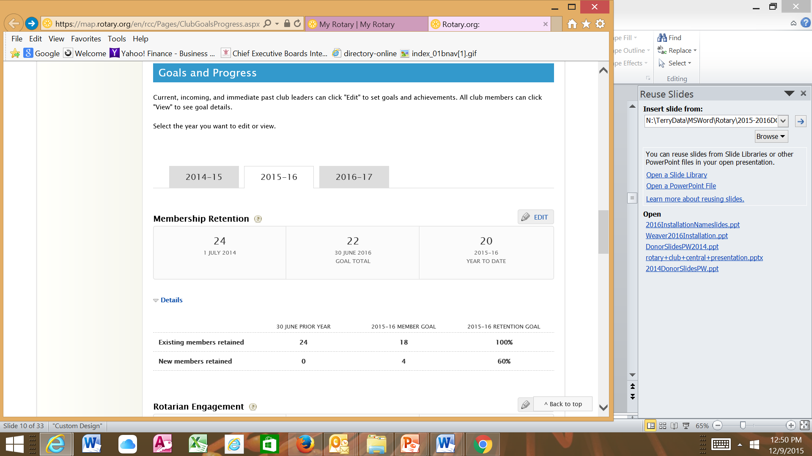
Set & Edit Goals

Slide 17
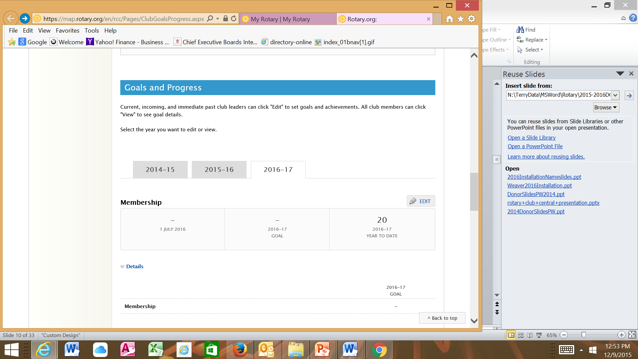
Set Goals

Slide 18
ROTARY CLUB CENTRAL
Help your clubs:
Enter and Edit Goals
Enter Progress Information

Slide 19
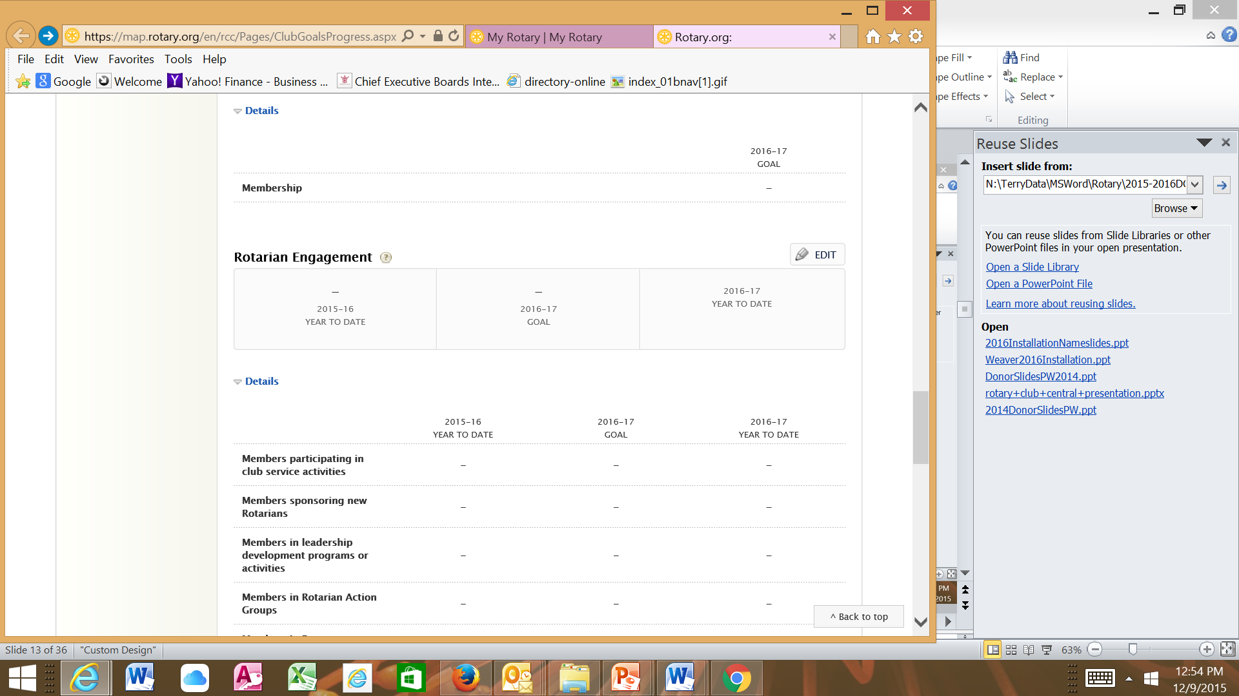
Enter
Progress

Slide 20
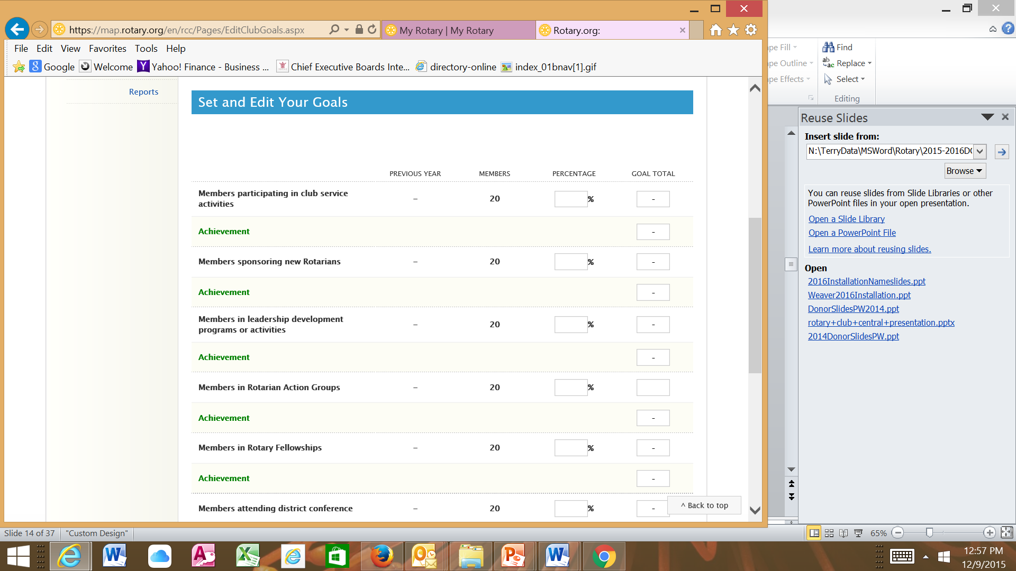

Slide 21
ROTARY CLUB CENTRAL
Help your clubs:
Enter and Edit Goals
Enter Progress Information

Slide 22
TRACK PRESIDENTIAL CITATION PROGRESS
MY ROTARY/Manage/Reports Scroll almost to the bottom of the page
AWARDS
Presidential Citation – View Reports
Presidential Citation Dashboards
Notes:
You will always begin on the Your Club tab [CLICK].
On this tab, you can View membership, communications & public relations goals for your club. Most of the clubs in our district are only using the membership section.
[CLICK] We start with the Trends section which shows your club’s membership retention over the last five years.
Scrolling down further….
[CLICK]

Slide 23
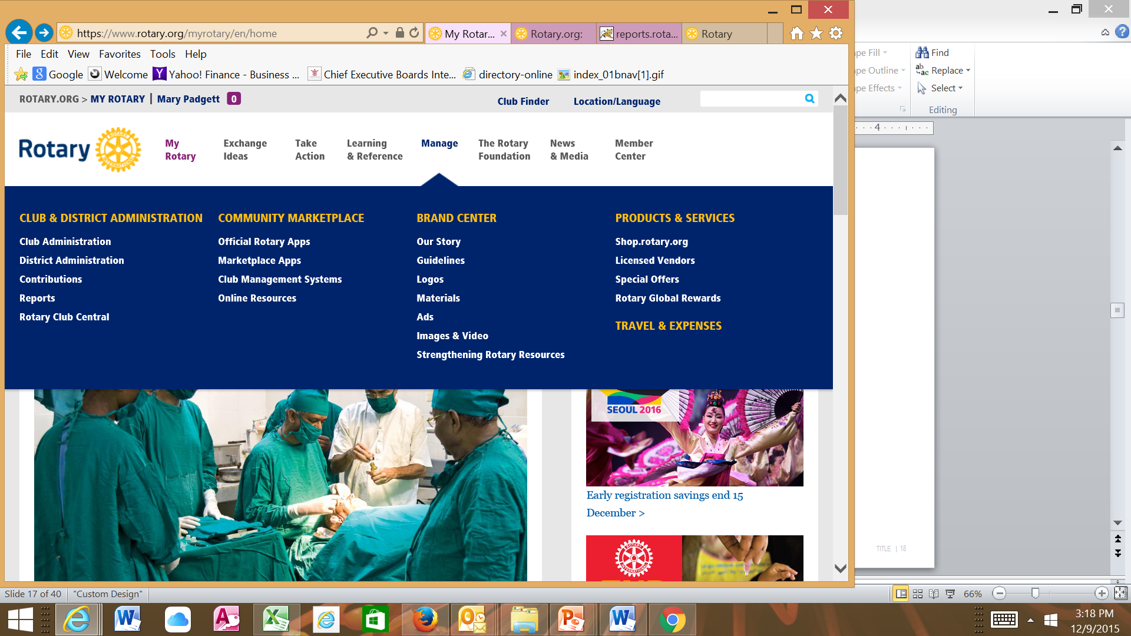

Slide 24
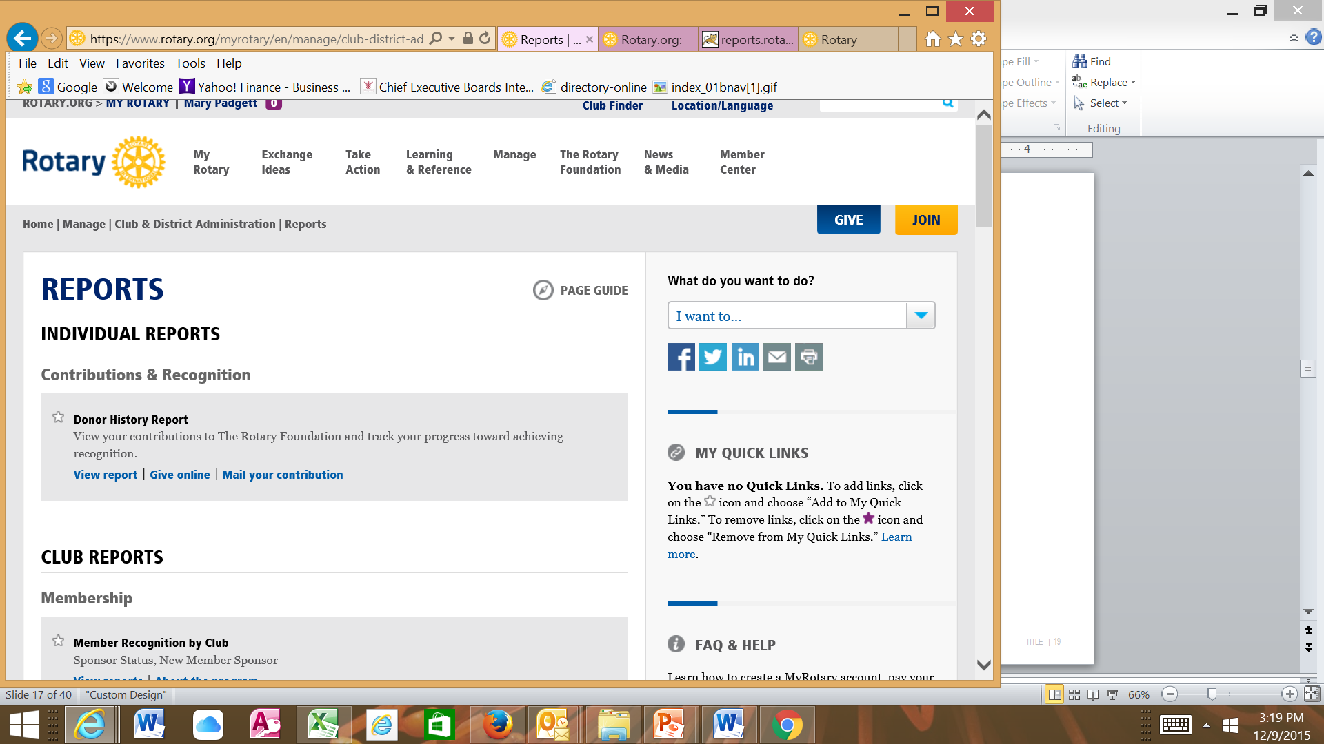

Slide 25
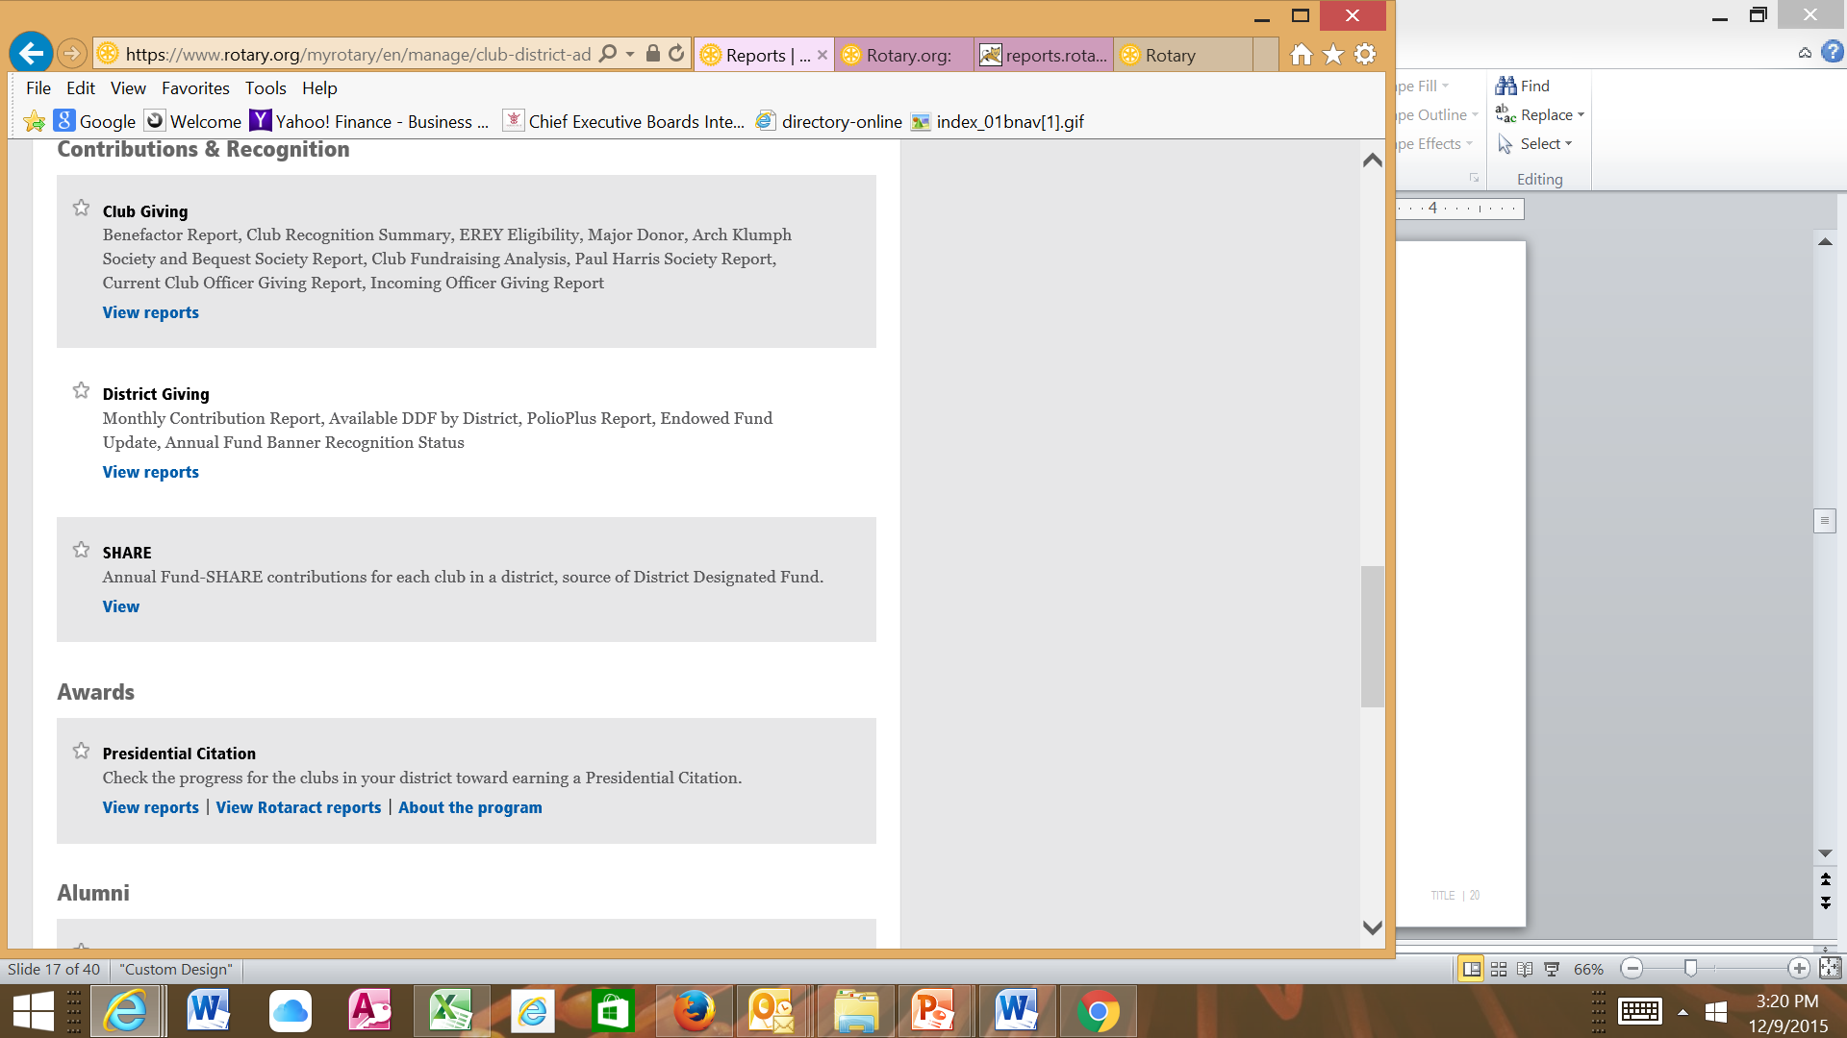

Slide 27
Important Time Line
Start Filling Goals on Rotary Club Central
Make all your members create profiles before your year starts or not late than August 2016.
Monitor Progress
Report Achievement on RCC
Fulfill all criteria for Presidential Citation before 30th June, 2017

Slide 28
QUESTIONS?

