Slide 1
COMMUNITY SERVICES
MEDICAL SERVICES III
DTA (27TH MARCH 2016)
2016-2017
AVENUE CHAIR – RTN. RAMESH DASWANI
ROTARY INTERNATIONAL DISTRICT 3141
Notes:
Presenter’s Notes
The notes below and on each slide are intended for you, the presenter, to use as you deliver your presentation. These notes provide background information for the text on the slides as well as optional activities you can incorporate to make the presentation more interactive. Your audience may be your club, members of various clubs, or a single club that is not your own. Please adjust the language (our vs. your) to fit your audience.
Activity
Ask participants the following questions:
What is your club like? Is it lively and fun? Is it diverse and open to new ideas? Are members actively involved?
How can your club become more vibrant?

Slide 2
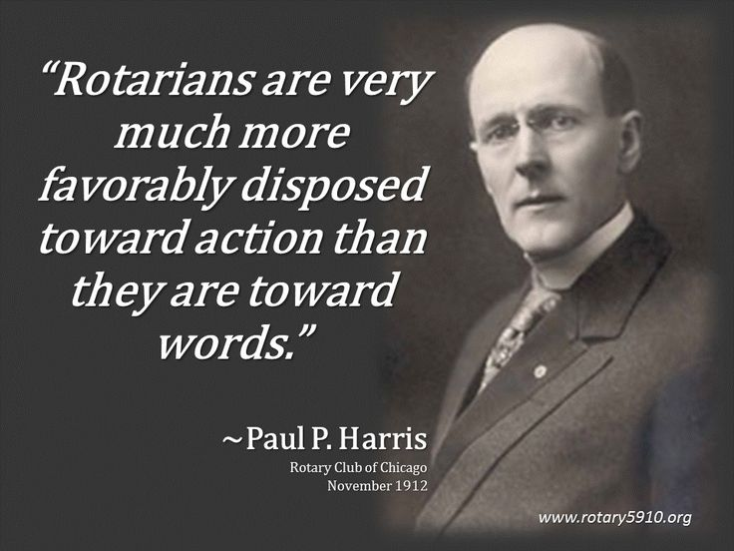
Rotary Club

Slide 3
MEDICAL SERVICES III
The officials
ADVISOR | RTN. DR. QURESH MASKATI | R. C. OF BOMBAY NORTH
AVENUE CHAIR | RTN. RAMESH DASWANI | R. C. OF BOMBAY CENTRAL
AVENUE CO-CHAIR | RTN. RAHUL GANDHI | R. C. OF MUMBAI NORTH ISLAND
AVENUE CO-CHAIR | RTN. PRAKASH MAURYA | R. C. OF MUMBAI ANDHERI
AVENUE CO-CHAIR | RTN. SHIRISH HASTAK | R. C. OF BOMBAY WORLI
Notes:
Add image

Slide 4
KIDNEY AND LIVER CARE
DISTRICT CHAIR | RTN. Dr. S .SIVRAM KRISHNAN | R. C. OF BOMBAY CHEMBUR WEST
DISTRICT CHAIR | RTN. ASHUTOSH PAWAR | R. C. OF MUMBAI DAHISAR
DISTRICT CHAIR | RTN. HARDEV PALHA | R. C. OF BOMBAY MID-CITY
STROKE PREVENTION
DISTRICT CHAIR | RTN. SUHAS PARIKH | R. C. OF MUMBAI DOWNTOWN SEA LAND
DISTRICT CHAIR | RTN. VINOD DEORAH | R. C. OF MUMBAI NORTH END
DISTRICT CHAIR | RTN. SHAILA VYAS | R. C. OF MUMBAI WEST COAST
DISTRICT CHAIR | RTN. SHOBHA SURESH | R. C. OF DEONAR
Notes:
The Rotary Strategic Plan stresses the importance of club innovation and flexibility. Strong clubs implement new ideas to increase their vitality and meet members’ needs.
There are about 34,000 Rotary clubs worldwide. Each club’s culture and practices make it unique. Each club should embrace the qualities that make it stand out from other clubs while striving to appeal to its community as a whole.
The best practices on the following slides are suggestions that can be adjusted to fit your club and its strengths. Consider them as possibilities that your club can discuss and as opportunities to think of creative ways to improve in certain areas, if you need to. Encourage members to be open to new ideas, and be sure that any decisions have strong member support.

Slide 5
CANCER AWARENESS & PREVENTION
DISTRICT CHAIR | RTN. VANDANA GUPTA | R. C. OF BOMBAY QUEEEN CITY
DISTRICT CHAIR | RTN. VIKRAM SANGHVI | R. C. OF BOMBAY AIRPORT
DISTRICT CHAIR | RTN. KAVITA KULKARNI | R. C. OF DEONAR
DISTRICT CHAIR | RTN. Dr. SUNIL KESWANI | R. C. OF DEONAR
DISTRICT CHAIR | RTN. SHOBHA SURESH | R. C. OF DEONAR
DISTRICT CHAIR | RTN.MALA SWARUP | R. C. OF MIDCITY
AIDS AWARENESS
DISTRICT CHAIR | RTN. SALIL MAROO | R. C. OF BOMBAY HARBOUR
DISTRICT CHAIR | RTN. DR. RASHMIKANT SHAH | R. C. OF BOMBAY NORTH WEST-MALAD
DISTRICT CHAIR | RTN. GIRISH JAIN | R. C. OF BOMBAY PIER
Notes:
Each club should have a strategic plan with a vision statement that describes where it wants to be in three to five years, as well as long-range goals to support that vision. All club members should have an opportunity to provide input on the plan to maximize innovative and diverse ideas.
Planning for the future keeps your club relevant to the community. It helps the club accomplish more significant projects over a longer period of time, with sustainable results.
Activities
Ask participants the following questions:
What vision do you have for your club?
What is special about your club?
What does your club do well?
Ask participants to think about what their vision for the club would be.
Give participants copies of the Strategic Planning Guide to help members understand the idea of strategic planning and begin thinking about their clubs’ strategic plans.

Slide 6
EYE CARE
DISTRICT CHAIR | RTN.DR. RUMI JEHANGIR | R. C. OF BOMBAY
DISTRICT CHAIR | RTN.PARTH SEJPAL | R. C. OF MUMBAI LAKERS
DISTRICT CHAIR | RTN.SUNIL NANGLIA | R. C. OF MUMBAI NORTH END
DISTRICT CHAIR | RTN.KIRAN PATEL | R. C. OF BOMBAY NORTH WEST-MALAD
DISTRICT CHAIR | RTN.RAMESH MOTWANI | R. C. OF MULUND
DISTRICT CHAIR | RTN.DR. S NATARAJAN | R. C. OF MUMBAI SION
DISTRICT CHAIR | RTN. DR. ASHOK PATEL | R. C. OF BOMBAY CENTRAL
Notes:
A strategic plan provides a “big picture” view of the club’s future. But for a club to achieve its long-range goals, it needs to break them down into smaller annual goals that can be achieved in each of the years covered by the plan.
Rotary Club Central is a tool designed to help your club develop its annual goals.
Setting goals ensures that your club is always striving to improve rather than simply accepting current practices.
Activity
Ask participants the following questions:
What are your club’s annual goals?
How were these goals set?
Who is responsible for entering the goals in Rotary Club Central?

Slide 7
DEAFNESS
DISTRICT CHAIR | RTN.DR. ANAND SHAH | R. C. OF BOMBAY
DISTRICT CHAIR | RTN. DR .BHARAT JOBANPUTRA | R. C. OF BOMBAY NORTH WEST-MALAD
DISTRICT CHAIR | RTN.DR. SAMIR BHARGAV | R. C. OF BOMBAY SEACOAST
DISTRICT CHAIR | RTN.MIHIR MEHTA | R. C OF QUEEN CITY
DISTRICT CHAIR | RTN.MAHENDRA THACKER | R. C. OF BOMBAY NORTH
Notes:
It is important to keep club members involved in the planning process and informed of all of the club’s initiatives. Club assemblies are an effective way to communicate with all members. Consider holding an assembly devoted to assessing the effectiveness of current club practices or generating innovative ideas. This would give all members an opportunity to provide input and offer suggestions. Members will be more likely to support and participate in an effort that they have helped develop.
Activities
Ask participants the following questions:
What else could club assemblies be used for?
Have your club assemblies been effective?
Have participants write down ideas they want the club to discuss at an assembly.

Slide 8
STROKE PREVENTION
Stroke is a global health problem. It is the second commonest cause of death and fourth leading cause of disability worldwide
Approximately 20 million people each year will
suffer from stroke and of these 5 million will not
Survive
400-800 strokes per 100,000
5.7 million Deaths
16 million new acute strokes every year
28,500,000 DALYs (disability adjusted life-year)
Notes:
Communicate club activities, news, and events on social media sites and club websites. Clubs can choose which methods to use, but they should keep the lines of communication open and establish a plan for sharing information.
Club members’ needs should be known and expressed to club leaders and, at times, to district leaders. Likewise, district initiatives should be communicated to club leaders and members.
Social media is growing in popularity and offers a great way to share information.
Activities
Ask participants the following questions:
Why do you visit your club and district websites?
What would you like to see on your club and district websites?
Pair members who are familiar with social media (for example, Facebook and LinkedIn) with a member who is not. Have them discuss the benefits of social media and the types of information shared through online social networks, as well as how to create an account.

Slide 9
CANCER AWARENESS & PREVENTION
8 lakh new cases/year
Tobacco-related cancers amenable for primary prevention
Oral cancers can be diagnosed early and treated successfully
13% of cancers in women (uterine cervix) can be screened and prevented
9% of cancers in women (breast) can be detected early and treated
Pediatric cancers are approx. 5.5% and Tata alone treats 200 New pediatric cases annually.
Notes:
Rotary leadership changes annually, which can make it hard to carry out a long-range plan. To help ensure continuity, clubs should select leaders well in advance and involve them in planning so they have input on decisions that will affect their terms.
Activities
Ask participants the following questions:
Who will your club leaders be in the next Rotary year?
Current leaders: What helped you prepare for your term? What would have prepared you better?
Does your club have a leadership track, a way to identify prospective leaders and develop their skills? If so, is it working? If not, would it help?
Have teams brainstorm a list of projects or processes that would require leadership continuity in order to be carried out effectively.

Slide 10
AIDS AWARENESS
India has the third largest HIV epidemic in the world. In 2013, HIV prevalence in India was an estimated 0.3%. This figure is small compared to most other middle-income countries but because of India's huge population (1.2 billion) this equates to 2.1 million people living with HIV. In the same year, an estimated 130,000 people died from AIDS-related illnesses.
Notes:
The Recommended Rotary Club Bylaws are meant to be adapted to your club. Your club’s bylaws should reflect your club’s current practices.
Activity
Have all members write down one practice they would like the club to stop and one they would like the club to adopt.

Slide 11
EYE CARE
15 million people in India are blind, which is 50% of world’s blind population.
In India 285 million people have visual impairment, including 39 million individuals who are blind and an additional 246 million who have poor vision.
The causes of moderate and severe vision impairment worldwide are uncorrected near-sightedness, farsightedness and astigmatism.
While the global statistics are alarming, India’s numbers are shocking with nearly half of all Indians in dire need of vision correction.
Notes:
We want members to keep coming back to meetings with enthusiasm, without feeling that they are boring or an obligation. Vibrant clubs are fun and have enthusiastic members.
If your club isn’t having fun, ask members for ideas that the club could implement to make it more fun.
Strong relationships are crucial for member retention. If new members are not welcomed properly or included in social circles at club meetings, disinterest or tension is likely to develop.
Rotary offers networking opportunities that should be promoted in recruiting efforts. These opportunities are attractive to young professionals.
Activities
Ask participants to shout out ways the club could have more fun, and write their responses on a flip chart.
Have participants get up and find someone they don’t know very well. Have each person tell the other person about something good that happened that week.

Slide 12
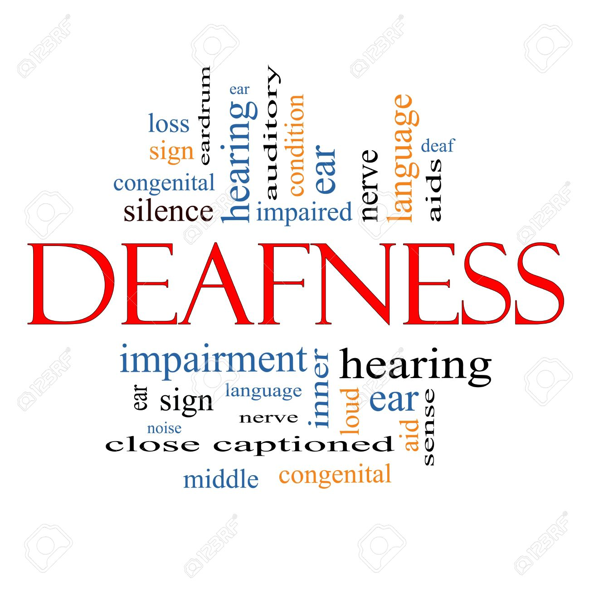
DEAFNESS
STATISTICS ABOUT HEARING LOSS
Hearing loss is the third leading chronic disability following arthritis and hypertension
9 out of every 10 children who are born deaf are born to parents who can hear
Profound hearing disability in India is about on million.
102 million people with severe hearing disability
09. million people with moderate hearing disability and 7.1 million people with very mild hearing disability
Notes:
How does your club involve members? Are members in your club engaged? If all members do is attend meetings, the club is not likely to be vibrant. Engaging members starts with talking to them about what they enjoy and what they would like the club to do. Developing club programs and activities based on members’ interests will ensure more active members.
Activities
Ask each participant to name a service project they would like to participate in, and write their responses on a flip chart. Then take one of those ideas and ask all participants to think of a skill they could bring to the project.

Slide 13
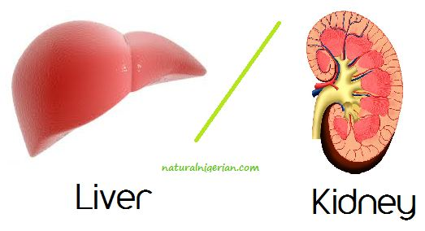
KIDNEY AND LIVER CARE
Number of adults with diagnosed kidney disease: 4.5 million
Percent of adults with diagnosed kidney disease: 1.9%
Number of deaths from nephritis, nephrotic syndrome, and nephrosis: 47,112
Deaths per 100,000 population: 14.9
Cause of death rank: 9
Notes:
District meetings, new member orientations, ongoing educational opportunities, and leadership development programs are all components of a comprehensive training plan.
To ensure that new and current members receive training, clubs should consider appointing a club trainer or, if the club is large, a training committee.
Clubs can also conduct a skills assessment to see which skills members would like training in.
Activity
Ask participants the following questions:
What training would you like our club to offer or participate in?
What training could be abandoned, combined, or radically changed?

Slide 14
ACTION PLAN OF THE DISTRICT AVENUE MEDICAL III SERVICES
WE WOULD ORGANIZE MULTIPLE HEALTH CAMPS IN URBAN SLUMS, SCHOOLS AND VARIOUS PUBLIC UTLITYS SPACES SUCH AS RAILWAY STATIONS AND PARKS.
SEMINARS AND AWARENES PANEL DISCUSSIONS ON EACH OF THE TOPICS:
EYE CARE
CANCER AWARENESS
DEAFNESS
KIDNEY AND LIVER
AIDS AWARENESS
STROKE PREVENTION.
For further details you may contact the co-chair or chair of the avenue
Notes:
Regardless of your club’s committee structure, all committees should address club vitality, member involvement, and your club’s needs.
Larger clubs might consider establishing additional committees to involve more members and accomplish more. Smaller clubs might consider combining committees to avoid having members serving in too many roles.
Activity
Ask participants the following questions:
Is there anything about your club’s structure that isn’t working?
Are there committees that could be added to help the club run better?
Are there some committees that aren’t needed?

Slide 15
ACTION PLAN OF THE DISTRICT AVENUE MEDICAL III SERVICES
ALL ROTARY CLUBS WOULD PARTICIAPTE AND ORGANIZE THE SAME.
4. WE WOULD DO AND SUPPORT A LARGE GLOBAL GRANT PROJECT IN THE FIELD OF HEALTHCARE.
For further details you may contact the co-chair or chair of the avenue

Slide 16
Thank you
Notes:
It is natural to fear change, but innovation doesn’t require abandoning all traditions.
Keep traditions that are meaningful to your club while fostering an environment that allows members to raise questions about club practices. Ask yourself:
Which traditions contribute to your club’s vitality?
What new ideas could your club try?
What positive changes have taken place recently?
What concerns do you have about change?
If the only reason for a particular practice is “we’ve always done it that way,” it probably isn’t contributing to the club’s vitality.
Activities
Ask participants the following questions:
Which traditions are meaningful and which do not contribute to your club’s vitality?
What new ideas could your club try?
Have participants form pairs and discuss some positive changes that have taken place in the club since they became members.

