Slide 2
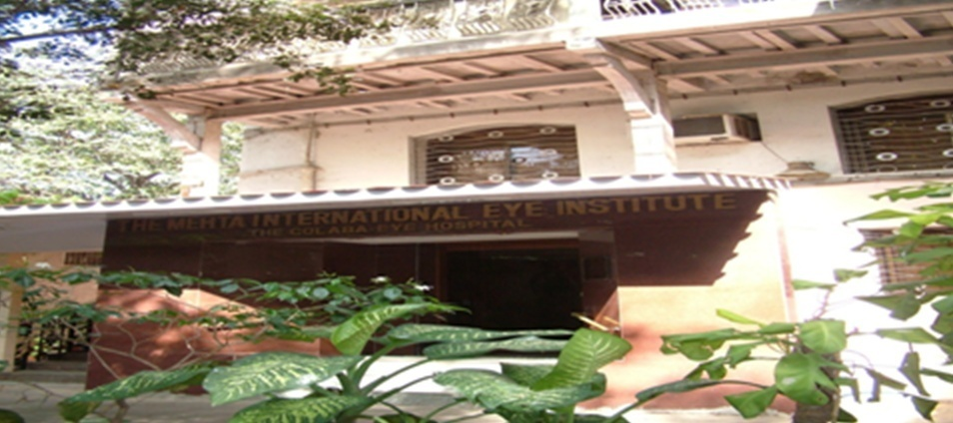
Prof. Dr. Keiki R. Mehta
MBBS., DOMS., MS.(Ophth), D.O. (IRELAND), R.C.P.&S.(Dublin),
D.O. (London), R. C.P.(London), R.C.S.(England), F.R.S.H. (London), F.I.O.S. (USA)
Mehta International Eye Institute,
Breach Candy Hospital,
D. Y. Patil Medical College and Hospital,
Mumbai
www.mehtaeyeinstitute.com
District Diabetes Thrust Programme
District : 3141

Slide 3
Presentation In Conjunction with
Arun Bhargava DSD
Dr Indumati Gopinathan Co Chair
Dr Cyres Mehta

Slide 4
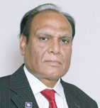
Why are we doing a Diabetic Awareness and Control as a Thrust area in Rotary District 3141 in 2016-2017

Slide 5
Diabetes and India
.
In 2000, India (31.7 million) topped the world with the highest number of people with diabetes mellitus followed by China (20.8 million) with the United States (17.7 million) in second and third place respectively.

Slide 6
Diabetes and India
India is facing an epidemic of diabetes. At present, confirmed diabetes patients in India are 67 million, with another 30 million in pre-diabetes group.
By 2030, India will have the largest number of diabetic patients in the world.

Slide 7
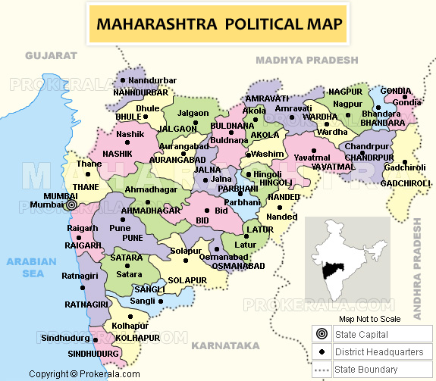
Maharashtra .. The Diabetic Capitol of India
A large community study conducted by the Indian Council of Medical Research (ICMR) showed low rates states of Northern India (Chandigarh 0.12 million, Jharkhand 0.96 million) South India 2,1 million as compared to Maharashtra (9.2 million)

Slide 8
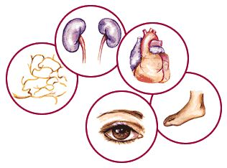
What Can Happen if Diabetes Is Not Under Control
Indians develop diabetes at an earlier age , it moves faster and has a higher rate of complication almost three times the world wide figures
:
Neuropathy (24.6%),
Cardiovascular (23.6%),
Renal failure (21.1%),
Eye problems(16.6%) and
Foot complications (5.1%).

Slide 9
How are we going to conduct the Diabetic Awareness and Control campaign

Slide 10
Organizing the Diabetes Awareness and Control program
Our target is to scan a 1-3 Lakh population
Organizing a mega event can seem like an incredibly overwhelming task.
And without organization and thinking ahead, it can be a disaster

Slide 11
First of all let us understand clearly the Role of the District and the Role of Individual Clubs in organizing this Mega Event

Slide 12
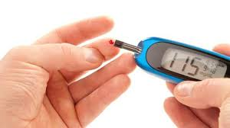
District Role
Organizing inauguration program, orientation program and closing program):
1. Provide Paramedic staff from Terna
2. Provide Blood collection staff from Thyrocare
3. Provide Blood testing strips
4. Provide Blood sugar testing machine
5. Provide Uniform design art work for: Banners, Posters, Pamphlets
6. Provide audio visual for running on camp sites.

Slide 13
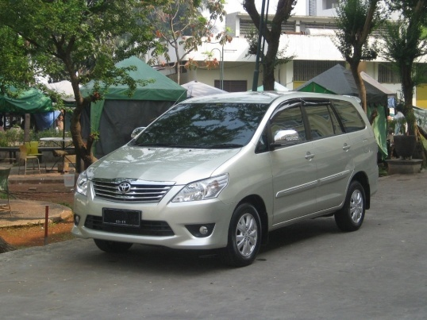
Vital stocking checklist
Hotline in place
Vans in Charge and Dispatch
Software in charge with Engineer availability if internet connections fail
Reportage and collection details

Slide 14
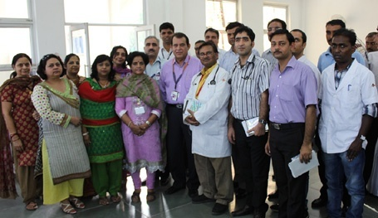
Clubs role
1. Each club has to appoint a District Thrust area Chairman or Director, who will coordinate with district team
2. Identify location for camp
3.Collaborate and involve Inner-wheel, Rotaract and Senior Citizen Groups
4.Pre Camp publicity in camp locality - distribution of pamphlets, posters, banner display, skit, nukkad natak, prabhat pheri etc
5. Provide laptops and secure transmission facility

Slide 15
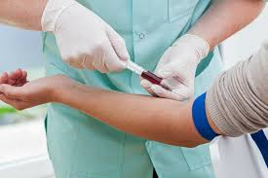
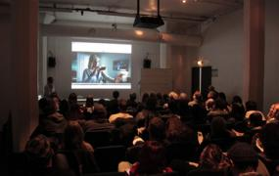
Clubs Role:…
6. Arrange doctors To seek the help of Doctors from different clubs
7. Doctor/Nurse to check blood sugar with strips
8. Assist Thyrocare staff in blood withdrawing of screened patients and safe storage ,transporting collected blood samples to their laboratories.
9. Play audio visual provided by district team
10. Prepare and send camp report in provided format to district team.

Slide 16
The Hub and spoke technique for the Diabetes detection camp
School/ colleges
Police.stn/
offices
The Main center
Church
/temple
Group living sites like baugs
Must Select high footfall sites

Slide 17
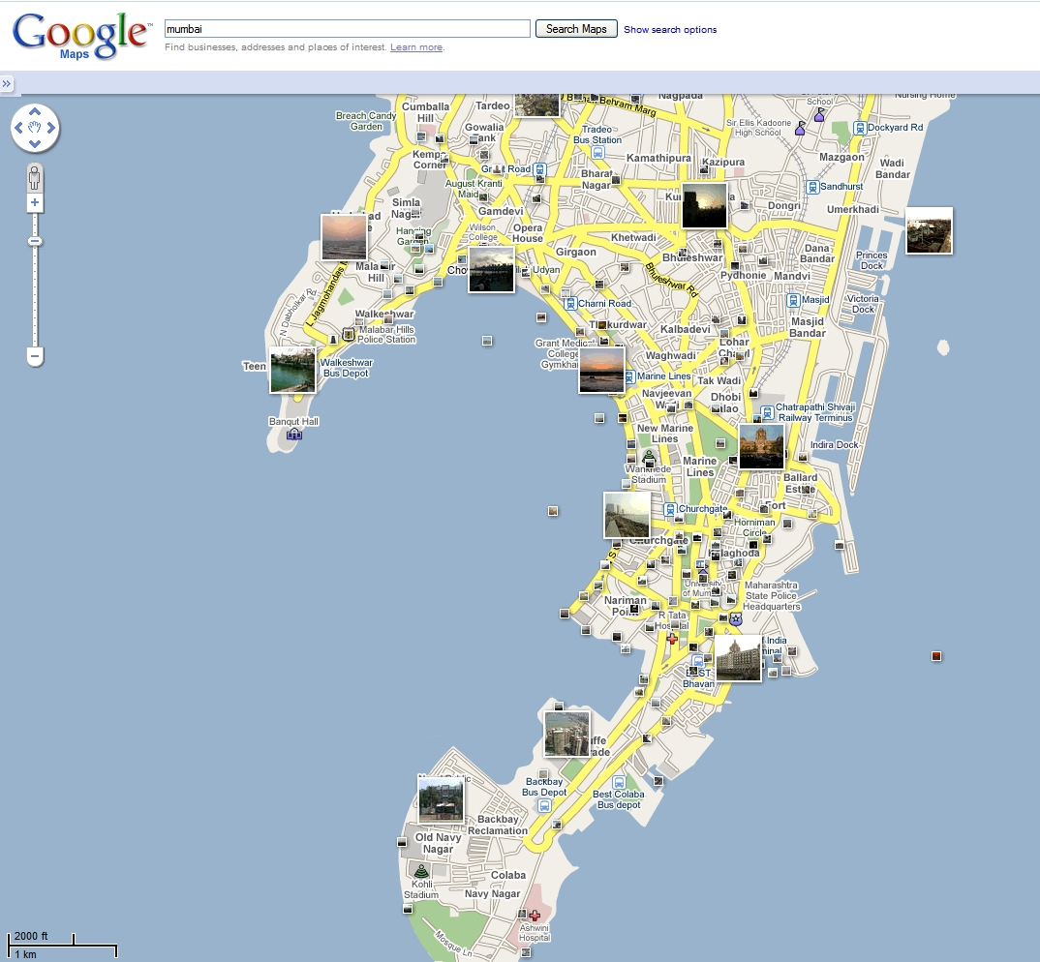
Finalize Fixed locations
Clubs
Zoparpatis,
Vendors
Malls
Police Stations
Colleges
Schools
Railway stations

Slide 18
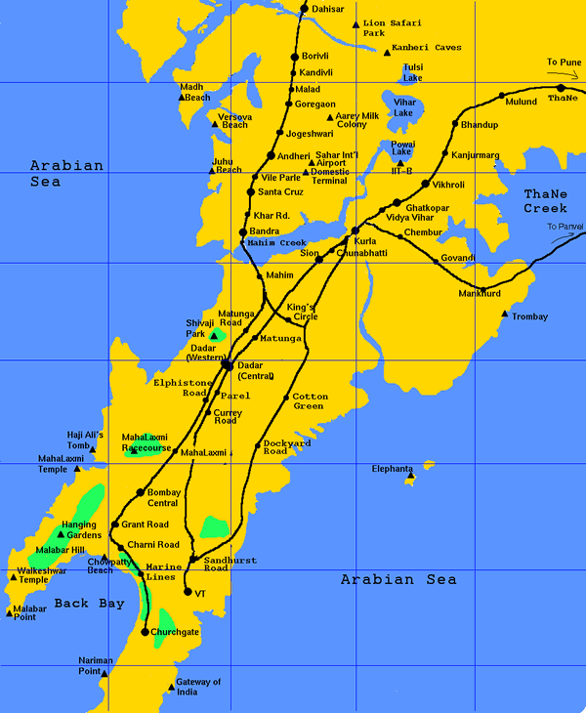
Mobile Locations with usage of van
The van will park outside
Schools
Colleges
Railway stations
Church, Mosque, Guradwara
High density locations
Key street junctions
Morning walk zones in different areas

Slide 19
How will the Diabetes tests be conducted

Slide 20
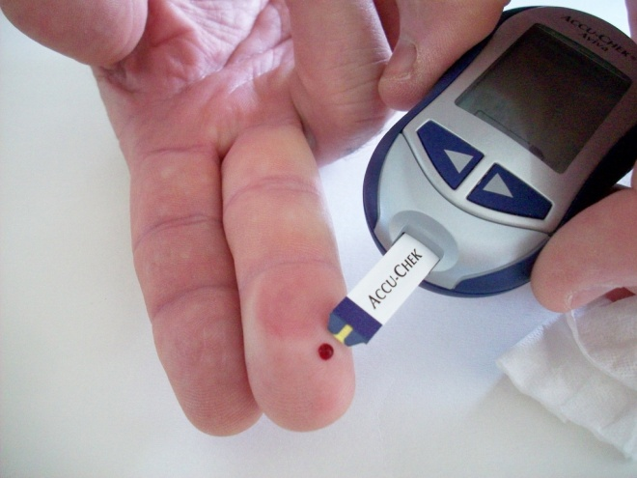
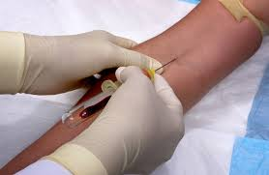
Blood evaluatory checks
Blood strip checks
At all sites
Blood Venous collection
At fixed high volume or cumulative sites

Slide 21
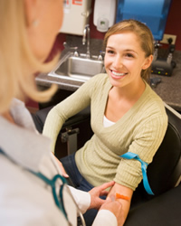
HbA1c? What is it , What does it mean

Slide 22
What is HbA1c?
The term HbA1c refers to glycated haemoglobin. It develops when haemoglobin, a protein within red blood cells that carries oxygen throughout your body, joins with glucose in the blood, becoming 'glycated'.
By measuring glycated haemoglobin (HbA1c), clinicians are able to get an overall picture of what our average blood sugar levels have been over a period of weeks/months.

Slide 24
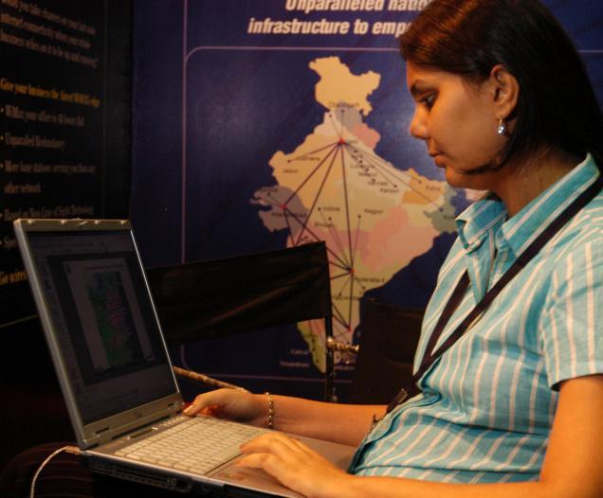
Collation and reportage
Management of blood collected
Reports to be sent by sms emails
Storage collection facilities
Reportage
Designated blood central collection reportage and which lab to send to Computer software to collate scientific referral and analytical analysis

Slide 25
Unfortunately Diabetes is associated with multiple complications

Slide 27
Thus, after we detect, the patient will have the option to look after the diabetic complications
The patient will be referred to
Diabetic Coordinative Centers

Slide 28
Coordinative centers
Eye :: All India Ophthalmological Society and Zeiss have agreed to set up 45 coordinative Care centers for retina care
Foot:: Indian Podiatry Association will set up key centers where the patient may be referred to
Cardiac:: Tied up with the Cardiological Society of India .. Member referral sites will be identified
Renal :: Indian Society of Nephrology will look after the side referrals
Peripheral Neuropathy : Neurological Society of India will decide in its December meeting

Slide 29
Marketing the program
The Clubs need to market the entire setup
Advisable to have young computer literate club member who can act as a PRO

Slide 30
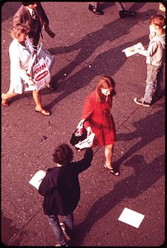
PUBLICITY PREPARATION
Release of headlines
Handbills
Posters
Banners
Print Media
TV Media
Laptops to get softwarewith internet cards

Slide 31
Digitally market the event.
Will Send out e-brochures, inform the media, send mailings, make sms’s, send messages to e-groups, and e-visit potential participants or sponsors.

Slide 32
#Effectively using social media
Standard is Facebook and Twitter, but there's a ton of other websites that can also be used to get the word out. Eventbrite, Evite and Meetup .

Slide 33
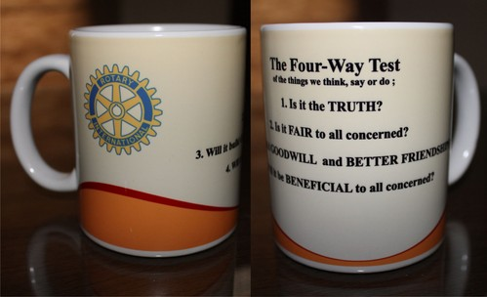
District will prepare a participants' kits
This sponsored kit will include a bottle of water, a packet of wafers, informative brochure and any information they may need.
It will also include small mementos. This is a nice touch that really convinces people that this is a well thought-out, organized event. And it makes them feel appreciated!

Slide 34
Our Logo and add ons

Slide 35
At the end of the project :
Club Reports diabetes projects to the district cabinet and to the local media:
Dispatches data to central Statistical analysis team for interpretation for publication
Club will share news about diabetes project successful implementation with the multiple district or district public relations chairperson.
Submit stories and photos via the Rotary International Social Media

Slide 37
Tour for Diabetes
Similar to the now famous Tour de Cure Cycling event run by the American Diabetic association
CELEBRATING 25 YEARS RIDING STRONG
13th Sunday November 2016

Slide 38
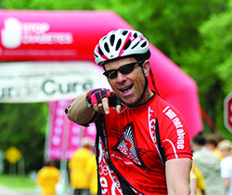
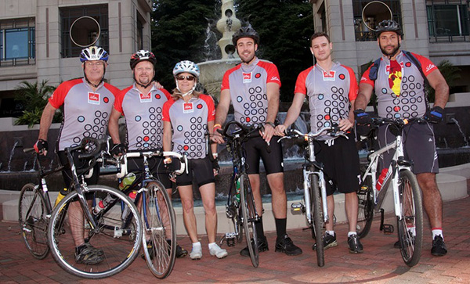
About the Tour
The Tour is a ride, not a race, with routes designed for everyone from the occasional rider to the experienced cyclist.
Whether you ride 1 miles or 10 miles, you will travel a route supported from start to finish with rest stops, food to fuel the journey and fans to cheer you on!
Each Tour de Cure event has its own character and style—from unique starting points to! . No matter where you ride you'll enjoy a fun day on your bike for a great cause.

Slide 39
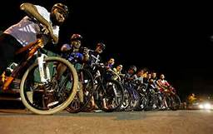
About the Tour
In 2014, more than 60,000 cyclists in 86 events raised more than $29 million to support the mission of the American Diabetes Association: to prevent and cure diabetes and to improve the lives of all people affected by diabetes.
Many people will participate in the Tour de Cure for the camaraderie and cycling challenge, but the real reward comes in knowing that every mile we ride and every rupee we raise brings us that much closer to stopping this disease that affects over 35 Lakh Indians .

Slide 40
Your District Diabetic Team
Chair Dr Keiki R. Mehta
Co chair Dr Indumati Gopinathan
Project coordinator : DSD Arun Bhargava
Mentor : PRID Ashok Mahajan :: Advisor: PDG Dr Bal Inamdar
Co Advisor PDG Madhukar Bhide
Medical Committee Medical Advisor Dr Shashank Joshi
Dr Kirit Mody, Dr Haresh Asnani , Dr Cyres Mehta ,
Dr Chandramohan Dawar, Dr Dinesh Panvalkar, Dr Anita Panvalkar, Dr Srikant Bhoyar, Dr Bhaskar Mehta ,Dr Arun Chowdhry
Strategic Partners Thyrocare : Seven hills hospital: Zeiss , Abbott , Lilly , Golds Gym Brahmakumaris

Slide 41
Gratefully acknowledge the contributions
1. Thyrocare for providing HbA1C and Thyroid test at highly subsidised rate. 2. Terna Dental college for providing 400 paramedics for our camps free
3. Seven Hills Hospitals for providing halls and auditorium free of cost to c
4. President Elect Vipul Gandhi for cash sponsorship of Rs. 10 Lacs.i 5. Cooper Hospital for providing infrastructure to conduct camps in their hospital. 6. Brahma Kumaries for providing close to 15 centers for conducting camps and providing volunteers and other facilities in those centers 7. Zeiss for glucometers strips and glucometers and free Fundus photos and evaluation and provision of Fundus cameras ( Rs 10 lakhs) 8. SUNWAYS for 40 vans plus persons 9. Abbott for donation of 1.5 lakhs 10. CareGroup for donation of 1.5 lakhs 11. AIOS. for donation of Rs 5 lakhs for evaluation and treatment for diabetics

Slide 42
.
Dates of Orientation programs:
1. Saturday, 3/9/16, evening at Ghatkopar Rotary Center
2. Sunday 4/9/16 morning at Juhu Rotary Center, combined with formal inauguration.
Date of Camp.
All clubs have to do camps independently: Sunday, 23rd September , 2016.
(PLUS)
Two subsequent Sundays will have high volume institutional based camps, which will be managed by selective clubs.
Final Ceremony and closing program: International Diabetes Day - Nov. 13th, 2016.

Slide 43
Diabetes has a great deal of ramifications for the entire family to whom it often comes as a shock

Slide 44
On hearing that her kidney’s are damaged due to undetected diabetes

Slide 45
A mother being told her baby has infantile diabetes

Slide 46
Husband consoling wife with diabetic retinopathy who has very limited vision and detected too late

Slide 47
Mother with child with diabetic gangrene following a minor infection .
Child to undergo below ankle amputation

Slide 48
But how do we look after those we have detected . Where do we get the finances to care for those who will need it the most For this I need your help

Slide 49
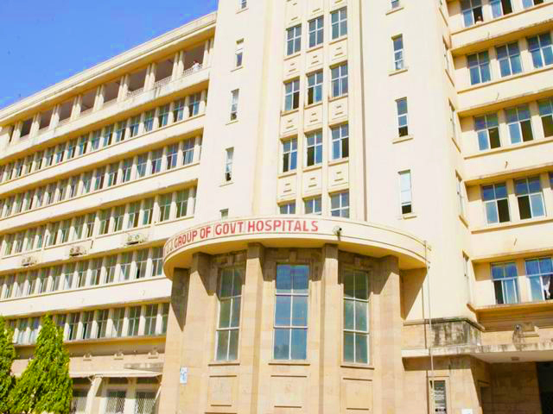
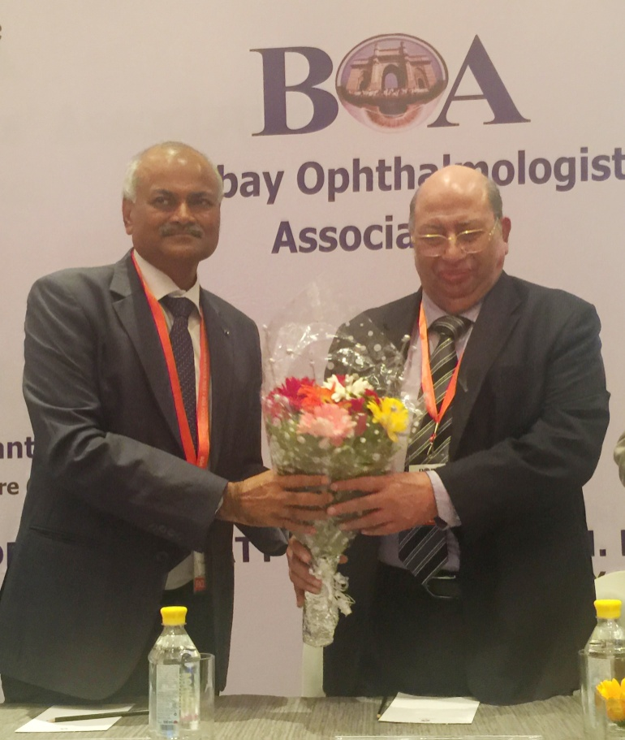
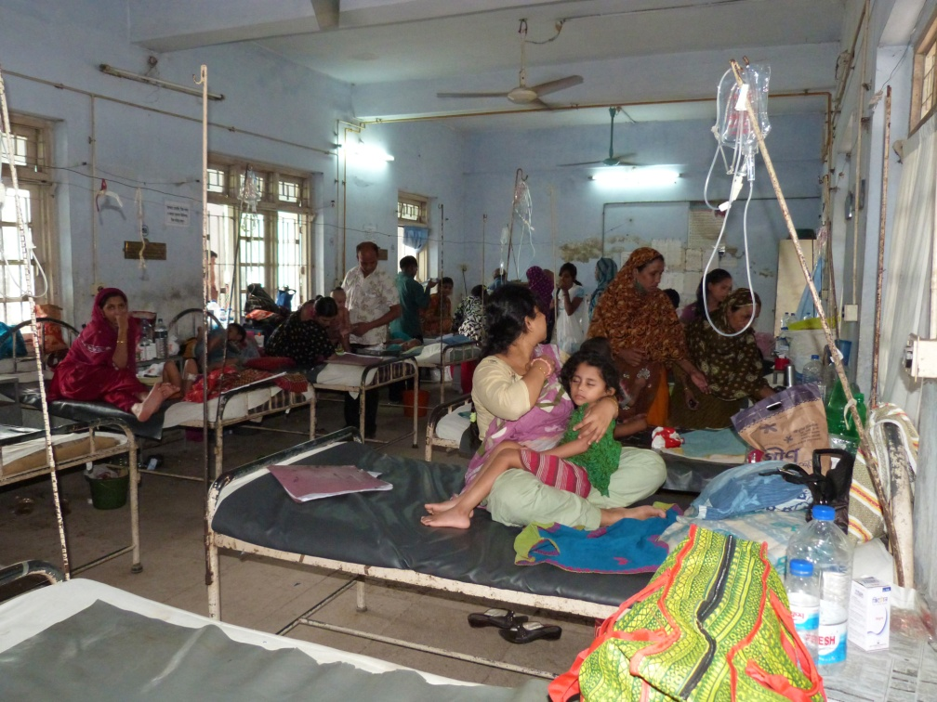

Slide 50
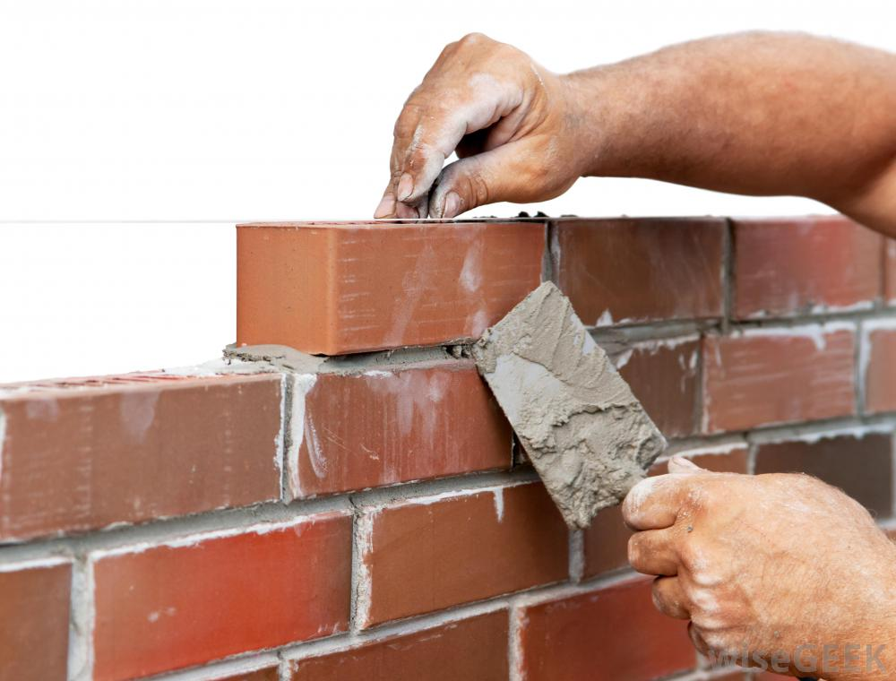
Build the Project BRICK BY BRICK

Slide 51
Bricks are the formative unit of any wall
A brick costs only Rs 1000
If 10 are selected an engraved disc will be given
If 50 are selected the Club gets a Bronze special award
If 100 are selected the Club gets a Silver specially crafted award
If 200 are selected the Club gets a Gold specially crafted award
Please donate generously

Slide 54
It will be a magnificent event and Rotary District 3141 can, and will be, truly proud of it

