Slide 2
COMMUNITY SERVICE MEDICAL-II
ADVISOR: DR.BADAR MASAKATI
AVENUE CHAIR: DR.KRISHNA KUMAR
CO-CHAIRMEN: HEMANT KORADIA
RAJU AGARWAL
HEMANT CHAUDHARI
DR.VINOD SIROYA

Slide 3
COMMUNITY SERVICE- II
MALARIA & OTHER VECTOR BORNE DISEASES.
LIFESTYLE DISEASES ( OBESITY, CHD, DM, HTN & CANCERS ).
TB AWARENESS & TREATMENT.
HOSPITAL UPGRADATION.
ALTERNATIVE MEDICINES.

Slide 4
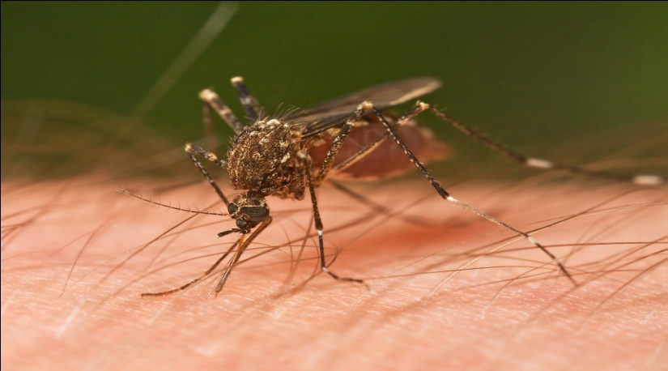
MALARIA & OTHER VECTOR BORNE DISEASES
ACCOUNT FOR 17% OF ALL INFECTIOUS DISEASE.
CAUSED > 1MILLION DEATHS ANNUALLY, MORE BY MALARIA.
BY MOSQUITOES: MALARIA, CHICKENGUNIYA, DENGUE, YELLOW
FEVER, JAPANESE ENCEPHALITIS, ZIKA.

Slide 5
CAUSES
UNPLANNED URBANIZATION.
CLIMATE CHANGES.
ROLE OF CLUB
EDUCATE & IMPROVE AWARENESS.
DONATE MEDICINES. DONATE ‘GUPPI’ FISH. 1 FISH CAN EAT 100 LARVAE.
DEFOG THE COLONIES / USE INSECTICIDE / PESTICIDE.
RC OF HIRANANDANI ESTATE, THANE HAS DONE FREE PEST-CONTROL, AT RETARDED CHILDREN HOME,BADLAPUR.

Slide 6
2. LIFESTYLE DISEASES
NON-COMMUNICABLE DISEASE.
KILL 38 MILLION PEOPLE/ YEAR, 75% DEATHS OCCUR IN
DEVELOPING COUNTRIES.
CV DISEASE ACCOUNT FOR THE MOST, FOLLOWED BY CA, RESPIRATORY
& DIABETES.
CAUSES
PHYSICAL INACTIVITY.
UNHEALTHY DIETS, HARMFUL USE OF ALCOHOL & TOBACCO.

Slide 7
RAPID UNPLANNED URBANIZATION & GLOBALIZATION.
UNHEALTHY LIFESTYLES.
ROLE OF CLUB
EDUCATE & CREATE AWARENESS.
REORIENTING HEALTH SYSTEMS.
EARLY DETECTION & TIMELY TREATMENT.
DG GOPAL IS STARTING A VERY BIG WAY “DIABETES” ORIENTATION CAMPS, ALSO TYING-UP WITH NEIGHBOURING DIST.

Slide 8
TB AWARENESS & Rx
TB IS TOP INFECTIOUS DISEASE KILLER WORLDWIDE.
95% TB DEATHS OCCUR IN LOW & MIDDLE INCOME COUNTRIES.
TB IS LEADING KILLER OF HIV+ PEOPLE.
5 LACS PEOPLE DEVELOPED MDR IN 2015.
CLUB’S ROLE
CONTINUE ONGOING TB PROJECTS.
RAISE AWARENESS FOR TB PREVENTION & CONTROL.
CARE & PREVENTION.

Slide 9
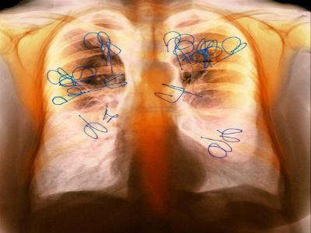
• The tuberculosis epidemic, that kills two Indians every three minutes showed no signs of abating in 2015 as the city registered a 20% increase in the number of patients registered for treatment over the last year.
(Courtesy: TOI of 20/03/16)

Slide 10
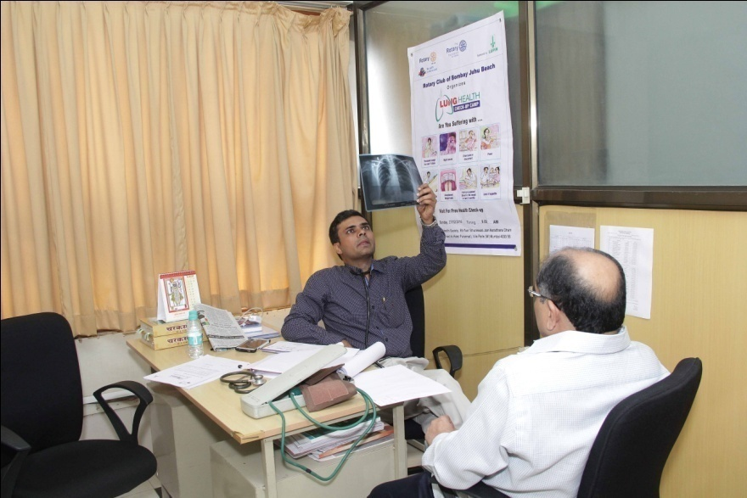
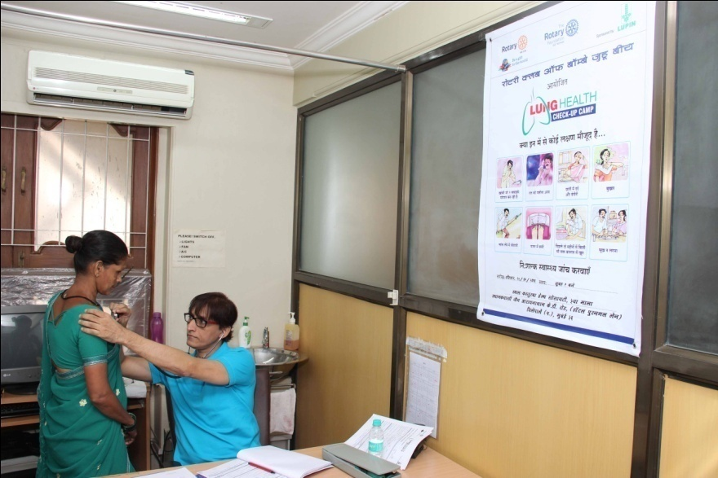
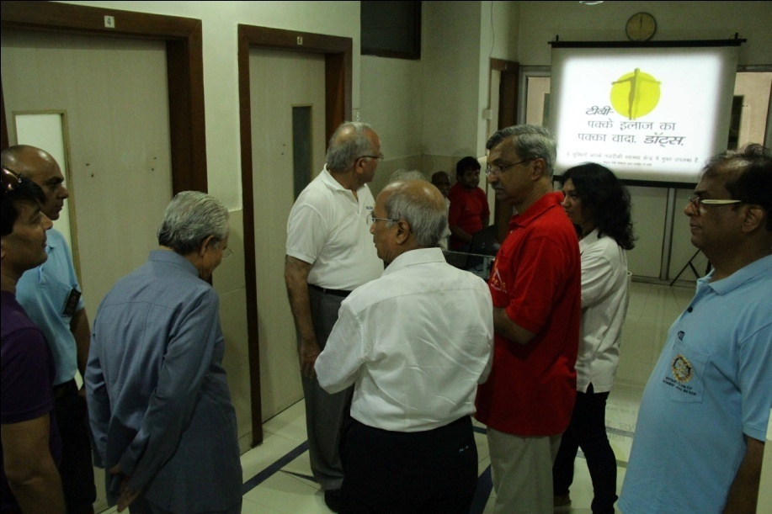

Slide 11
4. HOSPITAL UPGRADATION
SURVEY LOCAL BMC WARDS / HOSPITALS / DAYCARE CENTRES.
PREPARE LIST OF THINGS REQUIRED.
ARRANGE / FULFILL THE REQUIREMENTS.
VISIT REGULARLY.
SEEK GLOBAL GRANT.
PUT CLUB’S NAME / PROJECT / DONOR’S NAME ETC.

Slide 12
4. HOSPITAL UPGRADATION
RC BAYVIEW DONATED PORTABLE X-RAY MACHINE TO WADIA HOSPITAL, PAREL.
RC QUEEN’S NECKLACE SPONSORED EQUIPMENTS REQD FOR ‘BLOOD BANK’ @ SOMAIYA HOSPITAL. DONATED ‘TONOMETER’ TO CONWEST JAIN CLINIC, SPONSORING 8 NICU @ RUKMANI HOSPITAL & SET-UP OF ‘LOCAL REHABILITATION CENTRE’.
RC VERSOVA THRU’ GLOBAL GRANT UPGRADED ICU, DONATED MAMMOGRAPHY MACHINE & STARTED NEW OPD AT BSES HOSPITAL. DONATED 5 DIALYSIS MACHINES TO R.K. MISSION HOSPITAL, KHAR.
RCB JUHU BEACH INSTALLED 7 DIALYSIS MACHINES & A ‘RO PLANT’ AT DR. BABASAHEB AMBEDKAR SHATABDI HOSPITAL, KANDIVALI-WEST. CHARGES RS. 200/-UNDER PPP MODEL WITH MCGM. RUNNING COST BORNE BY NEMINATHJI JAIN FOUNDATION. SPACE PROVIDED BY MCGM.
RCB NARIMAN POINT DONATED A DIALYSIS MACHINE TO M. DADHICH HOSPITAL, S’CRUZ-EAST & TO NANA PALKER HOSPITAL, PAREL.
RC NORTH-WEST & WEST ARE ANOTHER EXAMPLES.

Slide 13
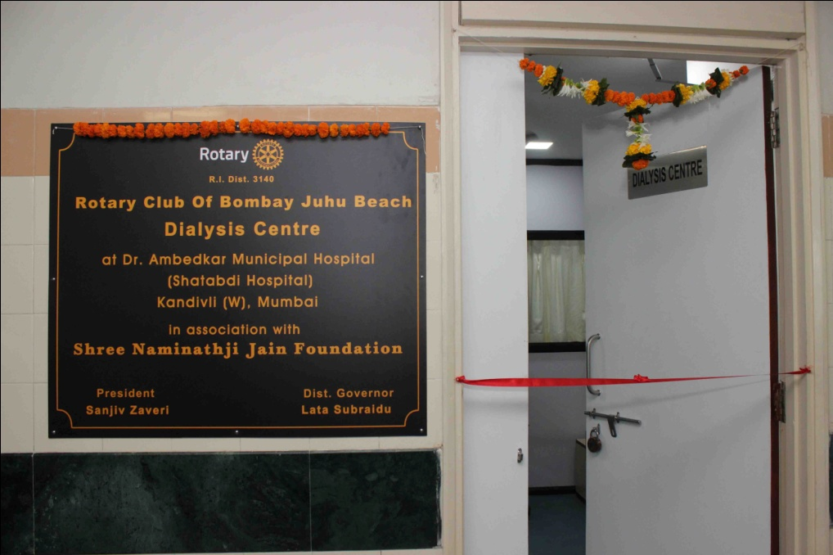
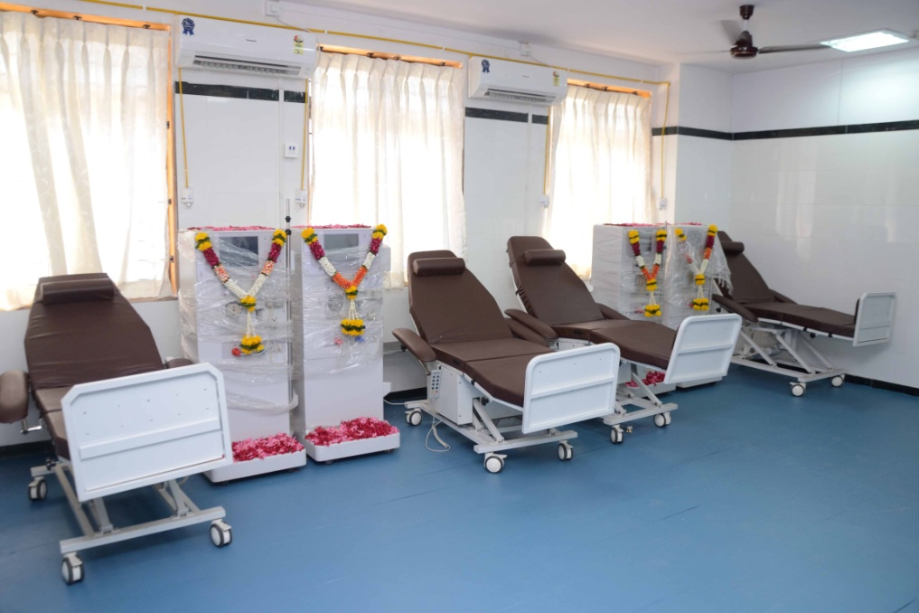
4. HOSPITAL UPGRADATION

Slide 14
5. ALTERNATIVE MEDICINES
IDENTIFY THE LEADING ALTERNATIVE SYSTEMS OF MEDICINE.
ORGANIZE SEMINARS / CAMPS ETC.
INVITE SPEAKERS FROM DIFFERENT SYSTEMS OF MEDICINE.
JOIN WITH DISTRICT’S MEGA MEDICAL CAMPS.

Slide 15
THANK YOU.
DR. KRISHNA KUMAR
AVENUE CHAIR – COMMUNITY SERVICE MEDICAL-II

